Slide 8
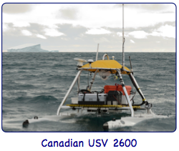
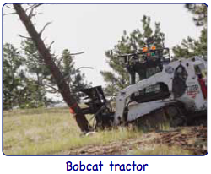
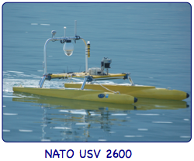
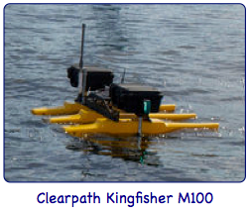
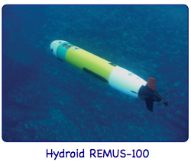
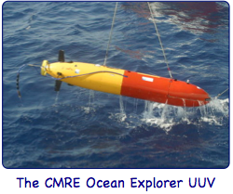
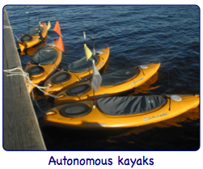
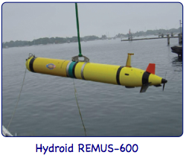
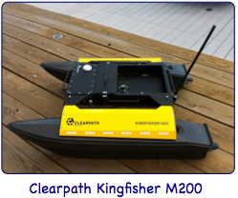
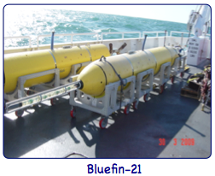
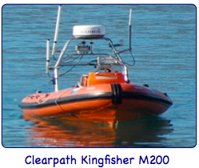
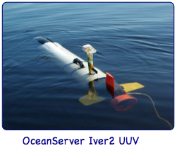
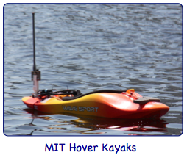
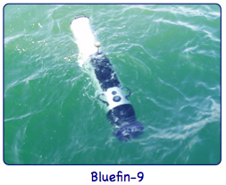
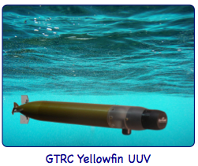
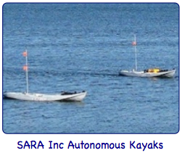

Slide 9
NATO USV 2600
Canadian USV 2600
Clearpath Kingfisher M200
Clearpath Kingfisher M200
Bluefin-21
Autonomous kayaks
Bluefin-9
OceanServer Iver2 UUV
Clearpath Kingfisher M100
MIT Hover Kayaks
Hydroid REMUS-100
Hydroid REMUS-600

Slide 12
Canada USV 2600
Kingfisher M200
H-Scientific USV
Yellowfin UUV
Autonomous kayaks
Bluefin-9
Iver2 UUV
Modified VideoRay
MIT Hover Kayaks
Hydroid REMUS-100
Hydroid REMUS-600
Univ. NB Glider
Kingfisher M100
Bluefin-21
NATO USV 2600
Bobcat tractor
SARA Kayaks
Ocean Explorer

