Slide 1
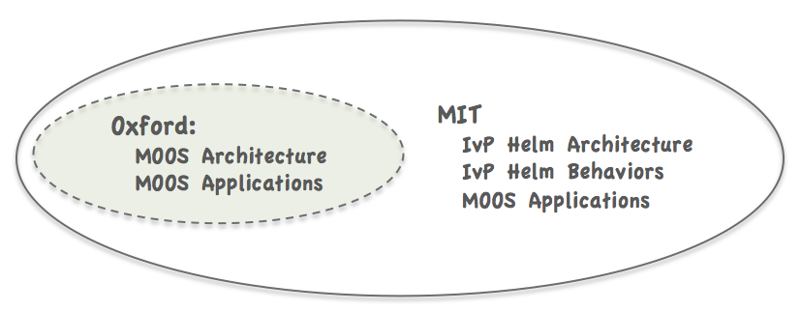
Unrestricted (public domain)
List of Developed MOOS Modules
(152 Modules)
Collaborations (user-to-user)
Your Apps
Your Behaviors
Oxford MOOS tree
The moos-ivp tree
moos-ivp-extend tree
MOOSDB
pLogger
iRemote
pScheduler
pShare
pMOOSBridge
umm
uMS
iMatlab
pAntler
uPlayback
pNodeReporter
uProcessWatch
uSimCurrent
uLogViewHelm
uTermCommand
pBasicContactMgr
alogclip
aloggrep
alogscan
uLoadWatch
uFldWrapDetect
uXMS
uFunctionVis
uTimerScript
pHostInfo
geoview
nsplug
alogrm
aloghelm
alogview
alogiter
iSay
uFldMessageHandler
uFldContactRangeSensor
uFldBeaconRangeSensor
uFldHazardSensor
uFldHazardMetric
uFldCollisionDetect
uFldPathCheck
uFldNodeComms
uFldNodeBroker
uFldShoreBroker
uFldScope
pHelmIvP
pMarinePID
uSimMarine
pMarineViewer
pEchoVar
uLogView
uLogViewIPF
uHelmScope
uPokeDB
uMAC
uMACView
Your MOOS Apps
Your Helm Behaviors

Slide 2
Unrestricted (public domain)
List of Developed MOOS Modules
(152 Modules)
Collaborations (user-to-user)
Your Apps
Your Behaviors
Oxford MOOS tree
MIT MOOS-IvP tree
moos-ivp-extend tree
MOOSDB
pLogger
iRemote
pScheduler
pShare
pMOOSBridge
umm
uMS
iMatlab
pAntler
uPlayback
pHelmIvP
alogcd
alogcheck
alogeplot
alogiter
alogpare
aloggrep
alogsplit
alogscan
alogclip
alogview
geoview
aloghelm
alogrm
pMarineViewer
uMACView
uFunctionVis
pMarinePID
pEchoVar
uPlotViewer
nsplug
uXMS
uMAC
iSay
zaic_hdg
zaic_peak
zaic_spd
zaic_vect
uFldHazardMgr
uFldHazardMetric
uFldNodeBroker
uFldShoreBroker
uFldNodeComms
uFldPathCheck
uHelmScope
uTimerScript
uProcessWatch
uTermCommand
pBasicContactMgr
uQueryDB
uPokeDB
pHostInfo
pDeadManPost
pEvalLoiter
pObstacleMgr
uCommand
uFldHazardSensor
uFldObstacleSim
uFldWrapDetect
uFunctionVis
uLoadWatch
uFldMessageHandler
uFldContactRangeSensor
uFldBeaconRangeSensor
pNodeReporter
uSimMarine
Your MOOS Apps
Your Helm Behaviors

Slide 3
Oxford MOOS tree
MIT MOOS-IvP tree
MOOSDB
pLogger
iRemote
pScheduler
pShare
pMOOSBridge
umm
uMS
iMatlab
pAntler
uPlayback
pHelmIvP
alogcd
alogcheck
alogeplot
alogiter
alogpare
aloggrep
alogsplit
alogscan
alogclip
alogview
geoview
aloghelm
alogrm
pMarineViewer
uMACView
uFunctionVis
pMarinePID
pEchoVar
uPlotViewer
nsplug
uXMS
uMAC
iSay
zaic_hdg
zaic_peak
zaic_spd
zaic_vect
uFldHazardMgr
uFldHazardMetric
uFldNodeBroker
uFldShoreBroker
uFldNodeComms
uFldPathCheck
uHelmScope
uTimerScript
uProcessWatch
uTermCommand
pBasicContactMgr
uQueryDB
uPokeDB
pHostInfo
pDeadManPost
pEvalLoiter
pObstacleMgr
uCommand
uFldHazardSensor
uFldObstacleSim
uFldWrapDetect
uFunctionVis
uLoadWatch
uFldMessageHandler
uFldContactRangeSensor
uFldBeaconRangeSensor
pNodeReporter
uSimMarine

