Slide 1
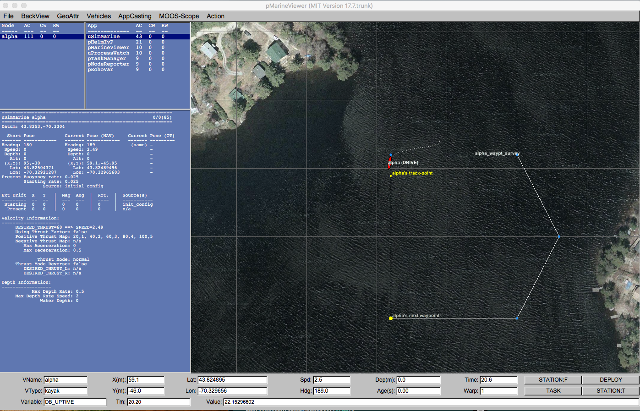

App
App
App
App
MOOSDB
App
App
App
App
pMarineViewer
Behavior
App
Behavior
MOOSDB
pHelmIvP
App
Behavior
App
App
STEM
File
(.moos)
PATCHED
File
(.moosx)
nspatch
PATCH
File
(.xmoos)

