Slide 1
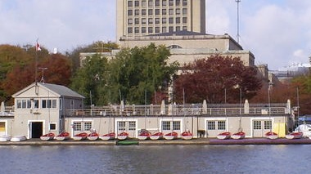
In-Field Topology
“Shoreside” could be:
User(s)
At a shoreside lab
MIT Pavilion
Instructor’s
computer
Shoreside
(Command and Control)
Shoreside
Vehicles
Vehicle
Vehicle
Vehicle
Vehicle
Vehicle
Vehicle

Slide 2
In-Field Topology
User(s)
Large N Simulation
(Command and Control)
Sim Control
Sim Cluster
CPU
CPU
CPU
CPU
CPU
CPU
CPU
CPU
CPU
CPU
CPU
CPU
CPU
CPU
CPU
CPU
CPU
CPU
CPU

Slide 3
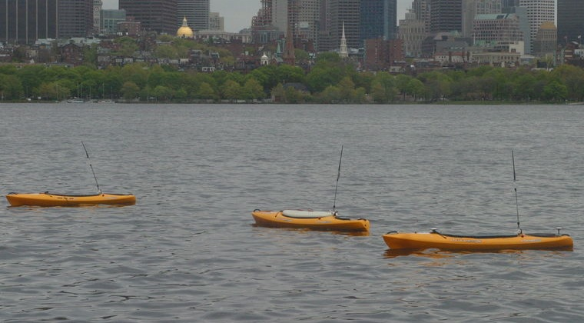
In-Field Topology
uFldContactRangeSensor
pMarineViewer
Simulator
Configuration
MOOSDB
OtherApps
pMOOSBridge
CRS_RANGE_REQUEST
Shoreside
WiFi
NODE_REPORT
CRS_RANGE_REPORT
Vehicles
pMOOSBridge
OtherApps
MOOSDB
pHelmIvP
pNodeReporter

