Slide 1
Hazard Search Competition Spring 2015 MIT 2.680
We would like to run TimeWarp = 20. We will go slower if your machines need need to run slower. Let us know.
To launch your missions:
IP Address 1.2.3.4
will be given at
run time
$ ./launch_vehicle.sh 20
--shore=1.2.3.4 --vname=jake
--mport=9000 --lport=9200
$ ./launch_vehicle.sh 20
--shore=1.2.3.4 --vname=kasper
--mport=9001 --lport=9001

Slide 2
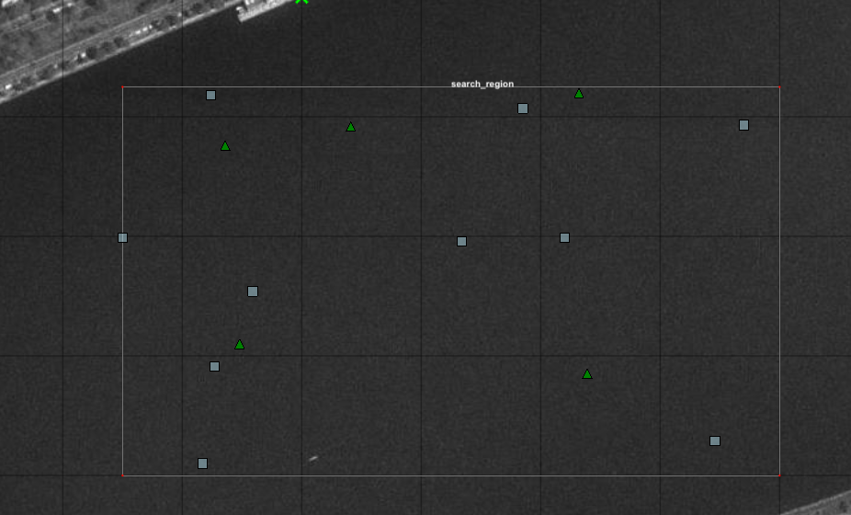
Scenario A
Object laydown: hazards.txt (exactly the baseline mission)
Penalty False Alarm: 150
Penalty Missed Detection: 25
Max Time: 7200
Penalty Time Over: 300
Penalty each second over: 0.25

Slide 3
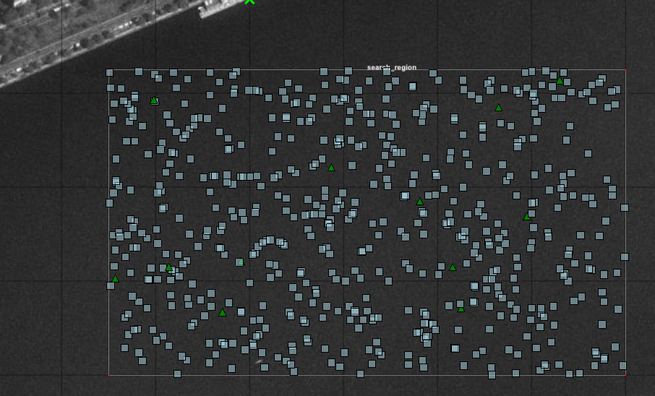
Scenario B
Object laydown: hazards_01B.txt (similar to hazards_01.txt in the baseline mission)
Penalty False Alarm: 250
Penalty Missed Detection: 15
Max Time: 6000
Penalty Time Over: 300
Penalty each second over: 0.25

Slide 4
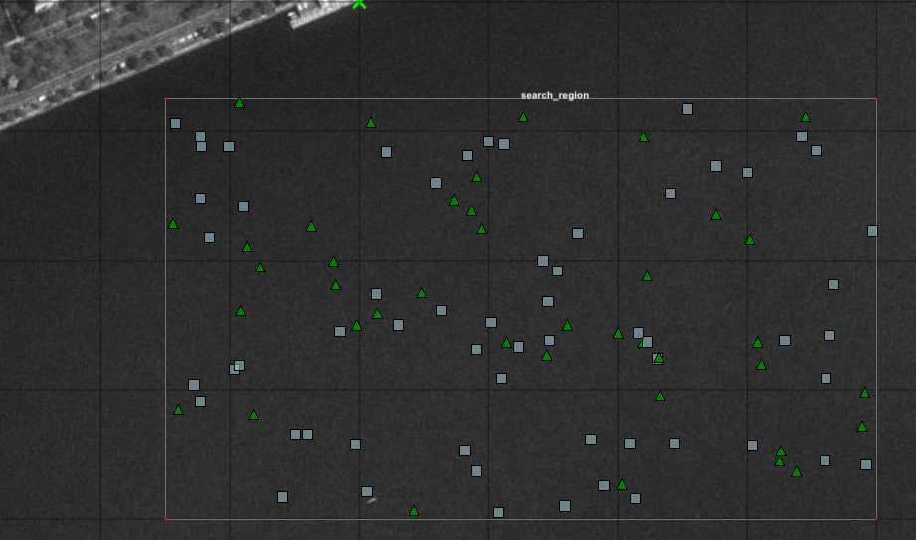
Scenario C
Object laydown: hazards_02B.txt (similar to hazards_02.txt in the baseline mission)
Penalty False Alarm: 100
Penalty Missed Detection: 45
Max Time: 5000
Penalty Time Over: 300
Penalty each second over: 0.25

Slide 5
Scores
Team | Scenario A | Scenario B | Scenario C

