Slide 1
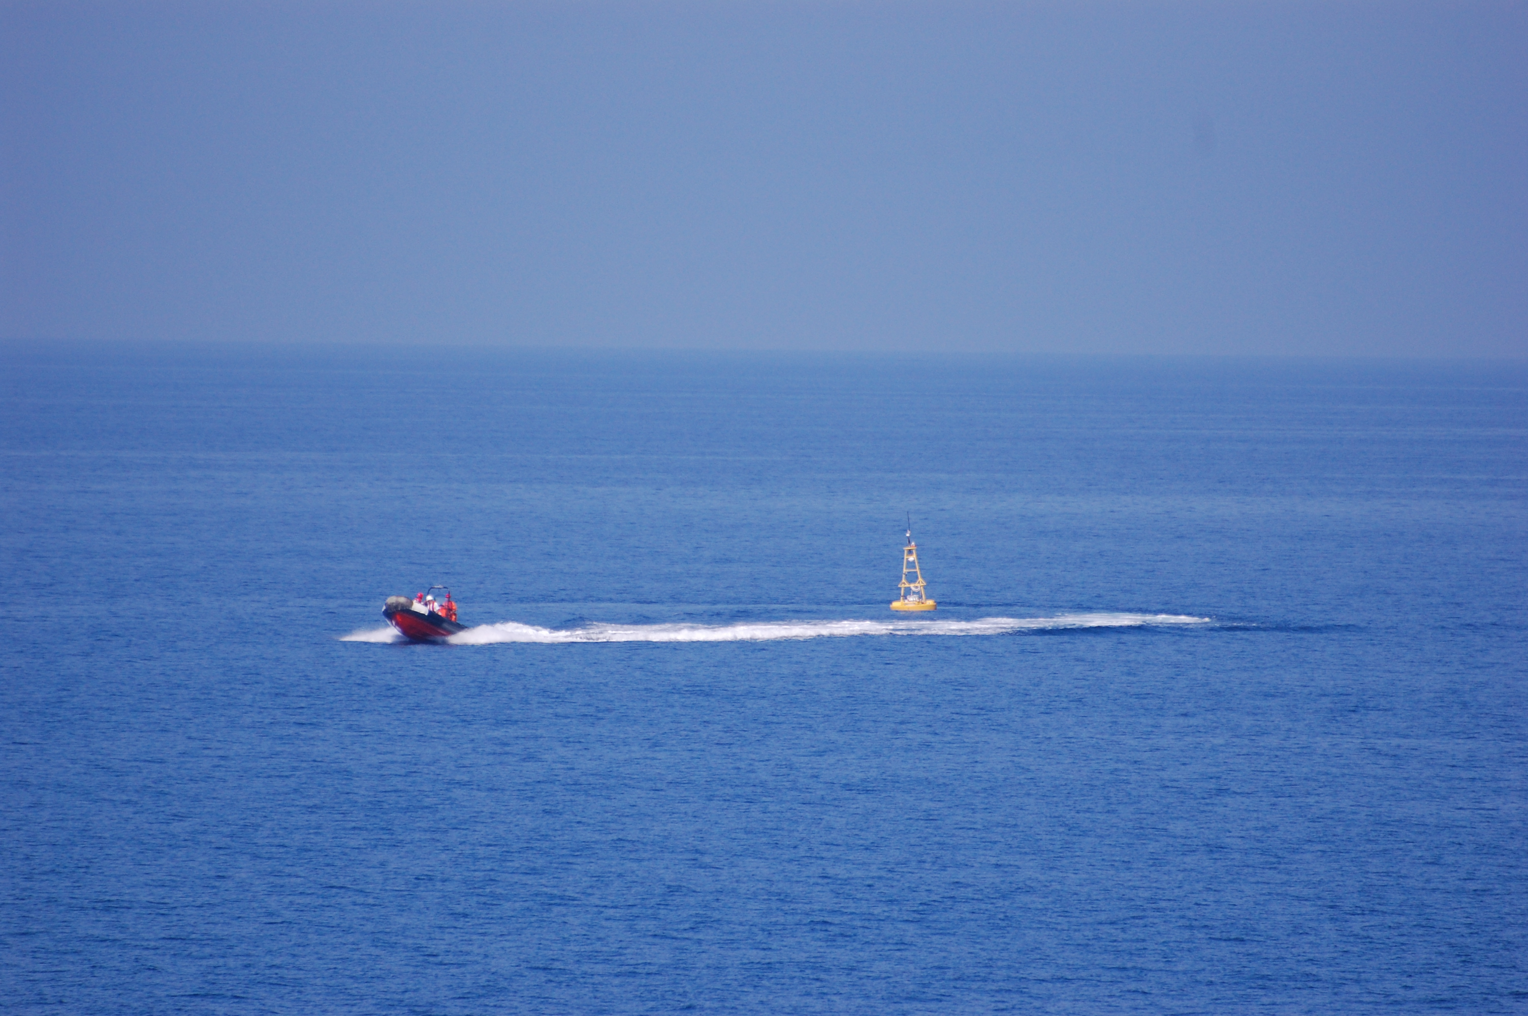
MIT 2.680 Unmanned Marine Vehicle Autonomy, Sensing, and Communications
March 7th, 2013
Autonomous Collaborative Search
Web: http://oceanai.mit.edu/2.680
Email:
Mike Benjamin, mikerb@mit.edu
Henrik Schmidt, henrik@mit.edu
Photo by Arjan Vermeij
GLINT ‘09
MIT 2.680 Spring 2013 – Marine Autonomy – “Lecture 9: Autonomous Collaborative Search”

Slide 2
Autonomous Collaborative Search 2.680 Lecture #9
Autonomous Collaborative Search
The mine countermeasure problem
The Search Timeline
Cyborg Search
Lab 09 Preview - collaborative search
Basic problem
Use of uFldHazardSensor
Teaming
Simulated Hazard Sensing with the uFldHazardSensor
MOOS Publish / Subscribe Interface
ROC Curves
- Sensor Configuration
Inter-Vehicle Messaging
The uFldMessageHandler MOOS App
Vehicle / Shoreside Topology and Routing
The uFldNodeComms MOOS App

Slide 3
Mine Countermeasures General Description
Mine Countermeasures (MCM) is the general problem of finding and neutralizing sea mines in an given area of operation..

Slide 4
Mine Countermeasures General Description

Slide 5
Mine Countermeasures Phases of Search: Broad Area Search
A Typical approach to MCM problem is to divide the mission into three phases:
Wide area search and detection
- Uniform, exhaustive search (lawnmower pattern)

Slide 6
An Example Case – (m10_jake example mission)
10 hazards, 8 rocks
Swath width=50 meters
P_{D} = 0.9, P_{FA} = 0.55, P_{C} = 0.6

Slide 7
An Example Case – (m10_jake example mission)
10 hazards, 8 rocks
Swath width=50 meters
P_{D} = 0.9, P_{FA} = 0.55, P_{C} = 0.6
This video can be found on the course wiki video page under lab #9 as clip #92:
http://18.38.2.158/2.680/clips/clip_92_lab_09_two_baseline.mov

Slide 8
Mine Countermeasures Phases of Search: Analysis
A Typical approach to MCM problem is to divide the mission into three phases:
Wide area search and detection
- Uniform, exhaustive search (lawnmower pattern)
- The result of this phase is a set of candidate objects and locations.
x
x

Slide 9
Mine Countermeasures Phases of Search: Re-acquire
A Typical approach to MCM problem is to divide the mission into three phases:
Wide area search and detection
Re-aquire, identify, and classify: Re-visit each point of the first phase with a finer sensor.
x
x

Slide 10
Mine Countermeasures Phases of Search: More Analysis
A Typical approach to MCM problem is to divide the mission into three phases:
Wide area search and detection
Re-aquire, identify, and classify
- Result of the second phase is a smaller list of High-Confidence targets
x
x

Slide 11
Mine Countermeasures Phases of Search: Neutralization
A Typical approach to MCM problem is to divide the mission into three phases:
Wide area search and detection
Re-aquire, identify, and classify
Neutralization – send a UUV to destroy the targets
x
x

Slide 12
The MCM Timeline Search Classify Map
SCM
PMA
RID
PMA
Neutralize

Slide 13
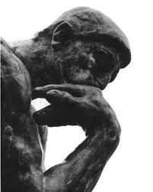
The MCM Timeline Post-Mission Analysis
SCM
PMA
RID
PMA
Neutralize
x
x

Slide 14
The MCM Timeline Re-acquire - Identify
SCM
PMA
RID
PMA
Neutralize
x
x

Slide 15
The MCM Timeline Post-Mission Analysis (Part II)
SCM
PMA
RID
PMA
Neutralize
x
x

Slide 16
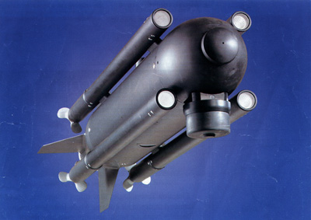
The MCM Timeline Neutralize
SCM
PMA
RID
PMA
Neutralize
Commercal Neutr. vehicle
Seafox (Atlas Electronik)
x
x

Slide 17
Mine Countermeasures (MCM)
SCM
PMA
RID
PMA
Neutralize
The Goal:
Shorten the timeline.
Sensors with greater swath width and better resolution.
Increasing the vehicle speed while holding sensor quality.

Slide 18
Mine Countermeasures (MCM)
SCM
PMA
RID
PMA
Neutralize
The Goal:
Shorten the timeline.
Computer aided algorithms
Distributed workload (perhaps off-site)

Slide 19
Mine Countermeasures (MCM)
SCM
PMA
RID
PMA
Neutralize
The Goal:
Shorten the timeline.
LESS FALSE ALARMS !!!!!
Use multiple vehicles
Sensors with greater swath width and better resolution.

Slide 20
Mine Countermeasures (MCM)
SCM
PMA
RID
PMA
Neutralize
Another way to shorten the timeline
What is needed to make this happen?
Sensor analysis is done on-board the vehicle while it is deployed.
Automatic Target Recognition
SCM
PMA
RID
RID
PMA
Neutralize

Slide 21
Mine Countermeasures (MCM)
SCM
PMA
RID
PMA
Neutralize
Another way to shorten the timeline
What is needed to make this happen?
SCM
Vehicle mission parameters are updated on the fly, as information becomes available.
PMA
RID
RID
PMA
Neutralize

Slide 22
Mine Countermeasures (MCM)
SCM
PMA
RID
PMA
Neutralize
Another way to shorten the timeline
What is needed to make this happen?
Sensor analysis is done on-board the vehicle while it is deployed.
Automatic Target Recognition (ATR)
SCM
PMA
On-board ATR is really hard problem.
To make this scenario work, we are replacing human experts looking at sensor data, with machines.
The consequences of missing a mine are HUGE.
Currently ATR does not have the full trust of human operators.
Does this mean we are back to doing PMA completely off-board?
RID
RID
PMA
Neutralize

Slide 23
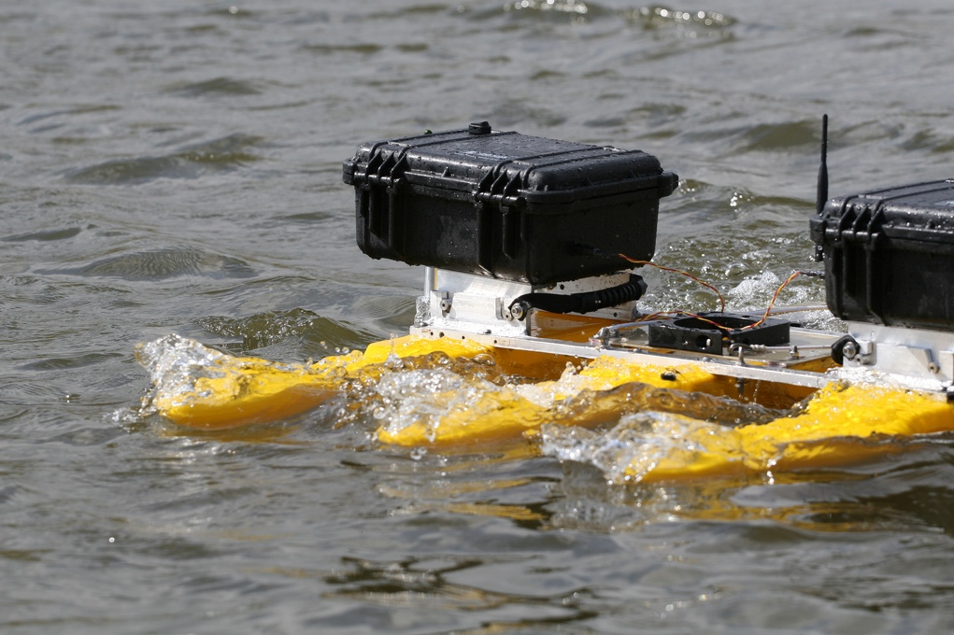
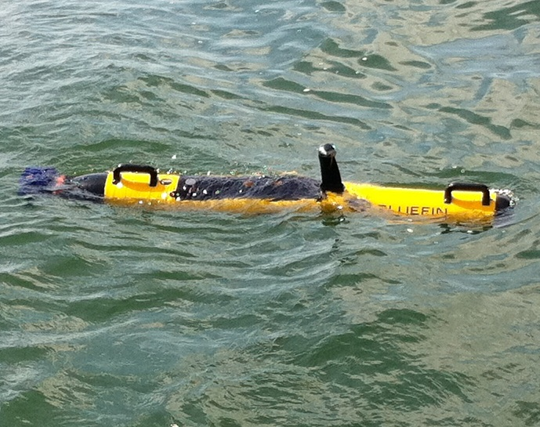
Cyborg Search
Deploy UUVs with on-board ATR algorithms.
Images of candidate targets are transmitted via acomms to gateway node, on to users
Humans decide if images are targets or not, or worthy of further investigation
Human feedback sent to UUVs, UUVs respond accordingly.
Target consensus is achieved before the UUV is recovered – no follow-up deployments

Slide 24
Cyborg Search
Deploy UUVs with on-board ATR algorithms.
Images of candidate targets are transmitted via acomms to gateway node, on to users
Humans decide if images are targets or not, or worthy of further investigation
Human feedback sent to UUVs, UUVs respond accordingly.
Target consensus is achieved before the UUV is recovered – no follow-up deployments
Experiments first in the Charles, then in Boston Harbor

Slide 25
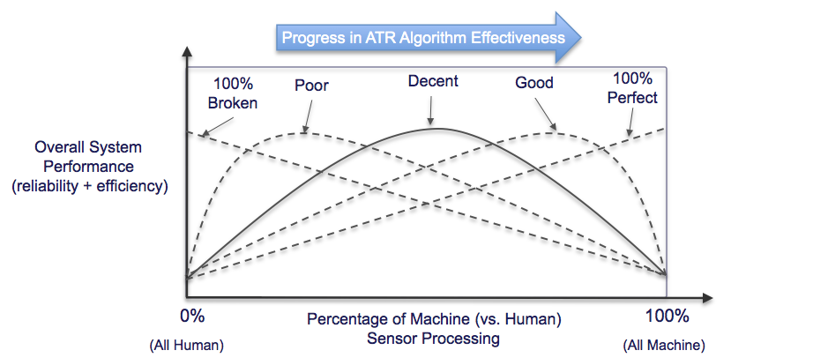
Cyborg Search
The term “cyborg search” came from the idea that the sensor-processing system is part machine, part human sensor processing.
Motivated by the below relationship:
Our proposed approach depends on ATR, but not completely
Allows for a non-perfect ATR algorithm to be used in an autonomous system similar to the original intended use for ATR algorithms.

Slide 26
Incorporating User Feedback
Will depend heavily on the best Acomms possible
Will require development of user interface to reported data
Will require additional adaptive autonomy on the vehicle
May want to develop an off-line coordinator to manage feedback from domain experts.

Slide 27
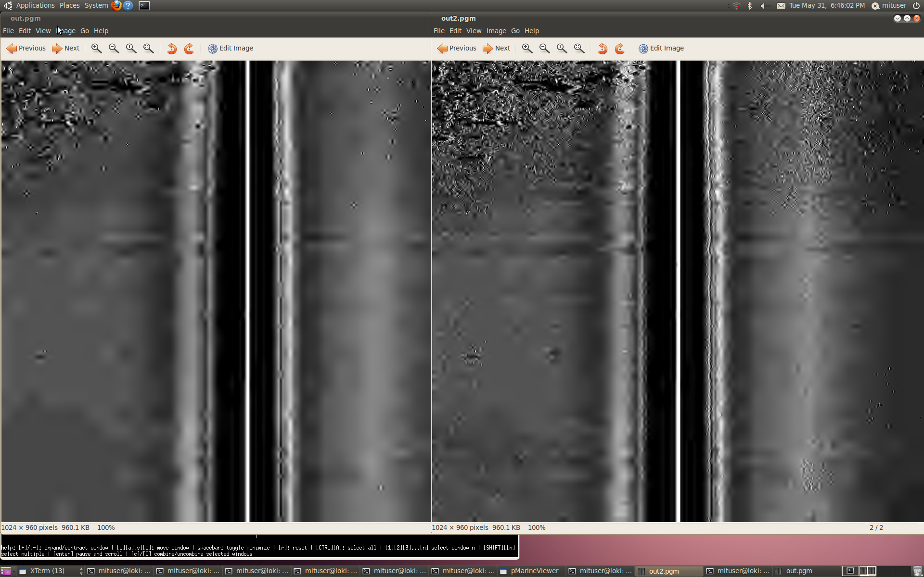
BF9 Marine Sonics Sidescan Sonar On-board Image
1 PSK message
2 PSK messages
Field Results from May 2011 Bluefin/MIT exercise with the BF9
In Boston Harbor.

Slide 28
Autonomous Collaborative Search 2.680 Lecture #9
Autonomous Collaborative Search
The mine countermeasure problem
The Search Timeline
Cyborg Search
Lab 09 Preview - collaborative search
Basic problem
Use of uFldHazardSensor
Teaming
Simulated Hazard Sensing with the uFldHazardSensor
MOOS Publish / Subscribe Interface
ROC Curves
- Sensor Configuration
Inter-Vehicle Messaging
The uFldMessageHandler MOOS App
Vehicle / Shoreside Topology and Routing
The uFldNodeComms MOOS App

Slide 29
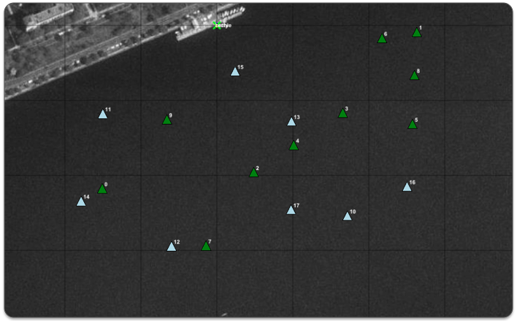
Lab 09 Preview Problem Statement
Handed out today
Due March 14th
Problem Statement: Search a hazard field given by a convex polygon area, with a set of hazardous objects and set of benign objects:
You don’t know the location of hazards
You know the polygon region
You don’t know the location of benign objects
Your job: Find the location of the hazardous objects while minimizing the false alarms. (We’ll say more about reward functions and optimization)

Slide 30
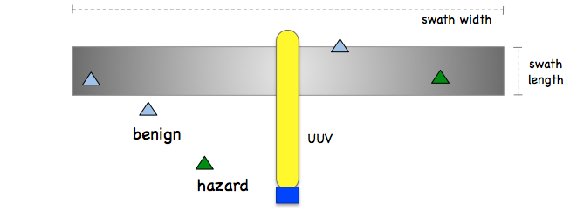
Lab 09 Preview Hazard Sensor
In this lab we will use the uFldHazardSensor MOOS App.
The uFldHazardSensor is a simulated detection and classification sensor.
It runs on the shoreside MOOS community
The user has configuration options trading off area coverage vs. accuracy.

Slide 31
Lab 09 Preview Teaming
In Lab 09, you are allowed to work in teams of 2.
By the end of this afternoon’s lab you should have identified a partner.

Slide 32
Autonomous Collaborative Search 2.680 Lecture #9
Autonomous Collaborative Search
The mine countermeasure problem
The Search Timeline
Cyborg Search
Lab 09 Preview - collaborative search
Basic problem
Use of uFldHazardSensor
Teaming
Simulated Hazard Sensing with the uFldHazardSensor
MOOS Publish / Subscribe Interface
ROC Curves
- Sensor Configuration
Inter-Vehicle Messaging
The uFldMessageHandler MOOS App
Vehicle / Shoreside Topology and Routing
The uFldNodeComms MOOS App

Slide 33
The uFldHazardSensor MOOS App Introduction
Subscriptions:
Publications:
uFldHazardSensor
NODE_REPORT
UHZ_CONFIG_REQUEST
UHZ_SENSOR_REQUEST
UHZ_CLASSIFY_REQUEST
Iterate()
Where is the vehicle
What objects are in its sensor field
Roll the dice, determine output
UHZ_DETECTION_REPORT_HENRY
UHZ_HAZARD_REPORT_HENRY
VIEW_CIRCLE
VIEW_MARKER
VIEW_POLYGON

Slide 34
The uFldHazardSensor MOOS App The Hazard Field
The hazard field:
Stored in config file
Loaded by uFldHazard Sensor
Vehicles know field boundary
(Read from configuration file)
Subscriptions:
Publications:
uFldHazardSensor
NODE_REPORT
UHZ_CONFIG_REQUEST
UHZ_SENSOR_REQUEST
UHZ_CLASSIFY_REQUEST
Iterate()
Where is the vehicle
What objects are in its sensor field
Roll the dice, determine output
UHZ_DETECTION_REPORT_HENRY
UHZ_HAZARD_REPORT_HENRY
VIEW_CIRCLE
VIEW_MARKER
VIEW_POLYGON

Slide 35
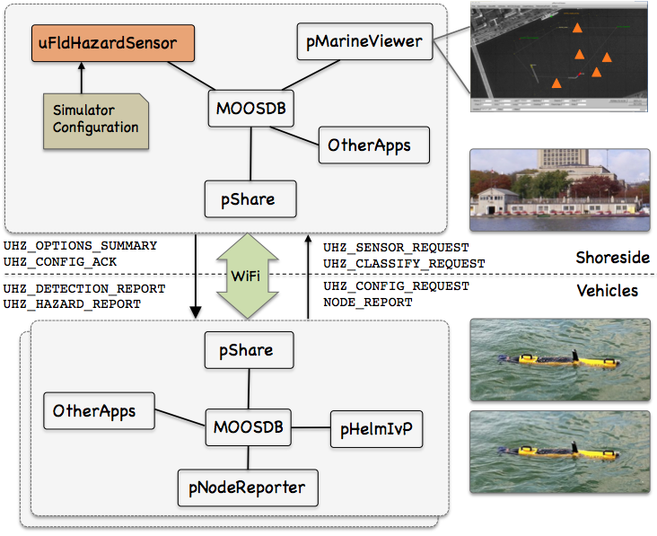
The uFldHazardSensor MOOS App App Topology
The Typical App Topolgy:
uFldHazardSensor on shoreside
A single configuration file
Easy way to ensure that multiple vehicles are using an identical simulated sensor configuration.
Vehicle is responsible for engaging with the simulator by posting to UHZ_SENSOR_REQUEST
The UHZ_SENSOR_REQUEST variable is bridged over pMOOSBridge to the shoreside.

Slide 36
An Example Case – (m10_jake example mission)
10 hazards, 8 rocks
Swath width=50 meters
P_{D} = 0.9, P_{FA} = 0.55, P_{C} = 0.6

Slide 37
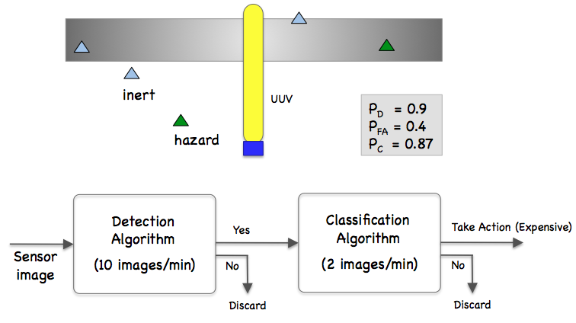
The uFldHazardSensor MOOS App Detections
Vehicle: activates the sensor
UHZ_SENSOR_REQUEST = “henry”
Shared to shoreside running uFldHazardSensor
Sensor: generates a detection
Object location
Object ID (label)
UHZ_DETECTION_REPORT_HENRY = x=51,y=11.3,label=12
Shared back to the vehicle
Vehicle: Interprets the output
The report itself is a detection.
Not all objects will generate a report (missed detections).
The report does not contain a classification. (hazard=true/false)
The user chooses the sensor configuration.
A sensor that provides richer data (and thus better detection/classification performance) comes at the cost of a reduced field-of-view.

Slide 38
An Example Case – (m10_jake example mission)
10 hazards, 8 rocks
Swath width=50 meters
P_{D} = 0.9, P_{FA} = 0.55, P_{C} = 0.6

Slide 39
The uFldHazardSensor MOOS App Classifications
Vehicle: requests classification
UHZ_CLASSIFY_REQUEST = “henry, label=188”
Shared to shoreside running uFldHazardSensor
Sensor: runs classify algorithm
Always provides an answer
UHZ_DETECTION_HAZARD_HENRY = label=12,type=hazard/benign
Shared back to the vehicle
Vehicle: Interprets the output
Up to the user to interpret this data w.r.t to whether the object is ultimately reported as a hazard or not.
Further passes may provide further certainty.
The user chooses the sensor configuration.
A sensor that provides richer data (and thus better detection/classification performance) comes at the cost of a reduced field-of-view.

Slide 40
The uFldHazardSensor MOOS App Classifications
Limits on classify requests
The algorithm may be run only once per 60 seconds (in this lab)
Set in the uFldHazardSensor config:
min_classify_interval = 60
A classify request will be honored only once per pass over the object.

Slide 41
An Example Case – (m10_jake example mission)
10 hazards, 8 rocks
Swath width=50 meters
P_{D} = 0.9, P_{FA} = 0.55, P_{C} = 0.6

Slide 42
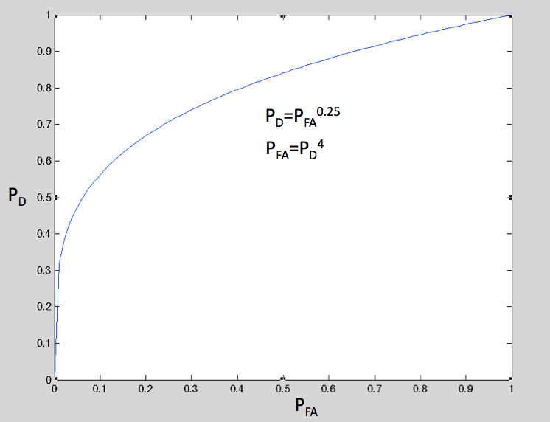
The uFldHazardSensor Detection Threshold
Detection Threshold:
The ideal is to have a probability of detection P_{D}=1 for actual hazards.
Equally ideal is a probabilty of false alarms, P_{FA}=0 for benign objects.
In practice, this is a tradeoff that is chosen by the user.
The “tradeoff curve” is often referred to as a ROC curver. (receiver operating characteristic)
The shape of the ROC curve is a fact life determined by your sensor and how it is configured to operate (e.g., swath width), and the performance of the sensor processing algorithm.
The point on the ROC is chosen by the user.
ideal sensor: P_{D}=1, P_{FA}=0
To simplify things in the uFldHazardSensor app, the shape of the ROC curve is determined by a single number: the exponent, e, in the equation: P_{FA}=P_{D}^{e}.
For e=4, if you want a P_{D} of 0.9, you have to live with a P_{FA} of 0.66

Slide 43
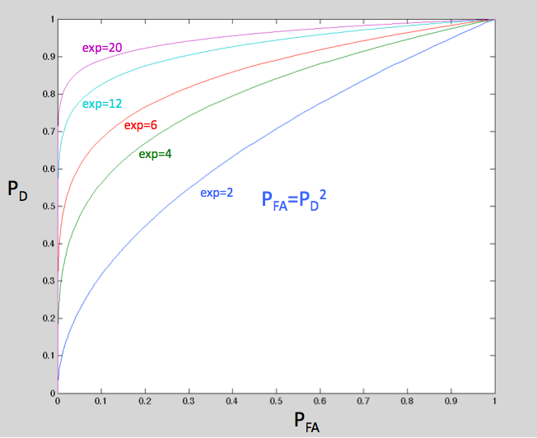
The uFldHazardSensor Detection Threshold
ROC Curve Options:
The sensor may have different configuration options, resulting in different ROC curves.
In the uFldHazardSensor, the ROC curve shape is directly tied to the swath width.
Bigger swath width, lower exponent.
uFldHazardSensor performance options:
The relationship between swath width and sensor performance is configure in the uFldHazardSensor configuration block with a series of options:
sensor_config = width=25, exp=4, class=0.80
sensor_config = width=50, exp=2, class=0.60
sensor_config = width=10, exp=6, class=0.93
Fact of life
User configuration – the user picks:
The sensor configuration option (e.g., swath width of 25 meters)
The point on the ROC curve:
Your choice
UHZ_CONFIG_REQUEST = vname=archie,width=25,pd=0.9

Slide 44
An Example Case – Searching for Underwater Objects
Simulation example: 10 targets, 8 rocks
Swath width = 25 meters
P_{D} = 0.9, P_{FA} = 0.55, P_{C} = 0.8
Swath width = 10 meters
P_{D} = 0.9, P_{FA} = 0.32, P_{C} = 0.93

Slide 45
The uFldHazardSensor MOOS App Possible Usage Scenarios / Suggestions
On the shoreside:
Note the configuration options
Note the search region
A pHandleSensorData app
Takes note of reported detections and classifications.
Fuses info from other vehicles.
Posts info locally to the MOOSDB.
uFldHazardMgr is a straw-man template.
A pHazardPath app
Generates initial search pattern.
Generates follow-on paths based on sensor data and your own stategy.

Slide 46
More Lab 09 Preview Given parameters and reward structure
An operation area containing some number of hazards and benign objects
Access to the uFldHazardSensor app, with certain sensor settings
Range-dependent intervehicle comms – unlimited in frequency and bandwidth
A time limit
A speed limit
A reward structure
Givens:
You don’t know the location of hazards
You know the polygon region
You don’t know the location of benign objects
Reward Structure:
Penalty False Alarms: 35
Penalty Missed Detections: 100

Slide 47
More Lab 09 Preview Given parameters and reward structure
An operation area containing some number of hazards and benign objects
Access to the uFldHazardSensor app, with certain sensor settings
Range-dependent intervehicle comms – unlimited in frequency and bandwidth
A time limit
A speed limit
A reward structure
Givens:
You don’t know the location of hazards
You know the polygon region
You don’t know the location of benign objects
Reward Structure:
Penalty False Alarms: 35
Penalty Missed Detections: 100

Slide 48
More Lab 09 Preview Normalizing the score
Reward Structure:
Penalty False Alarms: 35
Penalty Missed Detections: 100
By the raw reward structure, your best score will be ZERO (no penalties)
We’ve learned that MIT students do not like to aspire to “zero”.
Narmalized Score:
The worst score is calculated,
Number of known hazards x penalty for missed detections
+
Number of known benign objects x penalty for false alarms
Range of possible scores is [MAX_PENALTY, 0].
Normalized score of 0 assigned to MAX_PENALTY
Normalized score of 100 assigned to 0.

Slide 49
Autonomous Collaborative Search 2.680 Lecture #9
Autonomous Collaborative Search
The mine countermeasure problem
The Search Timeline
Cyborg Search
Lab 09 Preview - collaborative search
Basic problem
Use of uFldHazardSensor
Teaming
Simulated Hazard Sensing with the uFldHazardSensor
MOOS Publish / Subscribe Interface
ROC Curves
- Sensor Configuration
Inter-Vehicle Messaging
The uFldMessageHandler MOOS App
Vehicle / Shoreside Topology and Routing
The uFldNodeComms MOOS App

Slide 50
The uFldMessageHander App Inter-vehicle messaging
Vehicle alpha (source vehicle)
(Some MOOS App)
Publishes:
NODE_MESSAGE_LOCAL = “src_node=alpha,dest_node=bravo, var_name=STATUS,string_var=searching”
NODE_MESSAGE =
“src_node=alpha,dest_node=bravo, var_name=STATUS,string_var=searching”
Vehicle bravo (dest vehicle)
uFldMessageHandler Subscribes/Handles:
Publishes:
STATUS = “searching”

Slide 51
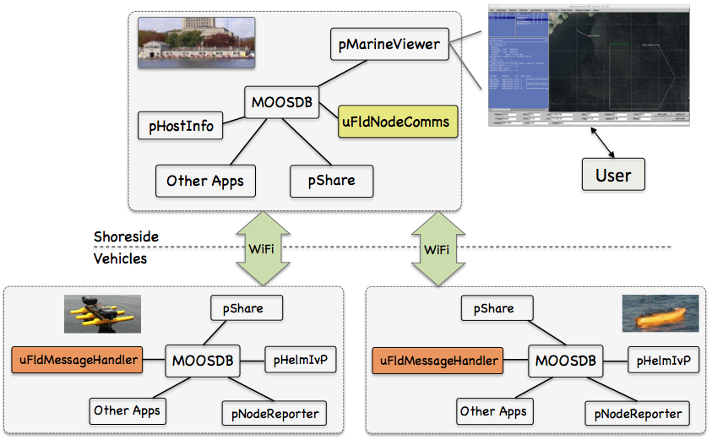
The uFldMessageHander App Typical Application Toplogy
The uFldMessageHandler app is running on all vehicles wishing to receive messages.

Slide 52
uField Message Routing
Message routing is handled on the shoreside
ProcessConfig = uFieldShoreBroker
{
QBRIDGE = NODE_MESSAGE
}
Shoreside
NODE_MESSAGE
NODE_MESSAGE_HENRY
Shoreside
Field
NODE_MESSAGE_LOCAL
NODE_MESSAGE
ProcessConfig = uFieldNodeBroker
{
BRIDGE = src=NODE_MESSAGE_LOCAL
alias=NODE_MESSAGE
}
Vehicle
Vehicle

Slide 53
uField Message Routing
Message routing is handled on the shoreside
But it’s not the case that all messages make it through
They are handled by uFldNodeComms.
ProcessConfig = uFieldShoreBroker
{
QBRIDGE = NODE_MESSAGE
}
Shoreside
NODE_MESSAGE
NODE_MESSAGE_HENRY
Shoreside
Field
NODE_MESSAGE_LOCAL
NODE_MESSAGE
ProcessConfig = uFieldNodeBroker
{
BRIDGE = src=NODE_MESSAGE_LOCAL
alias=NODE_MESSAGE
}
Vehicle
Vehicle

Slide 54
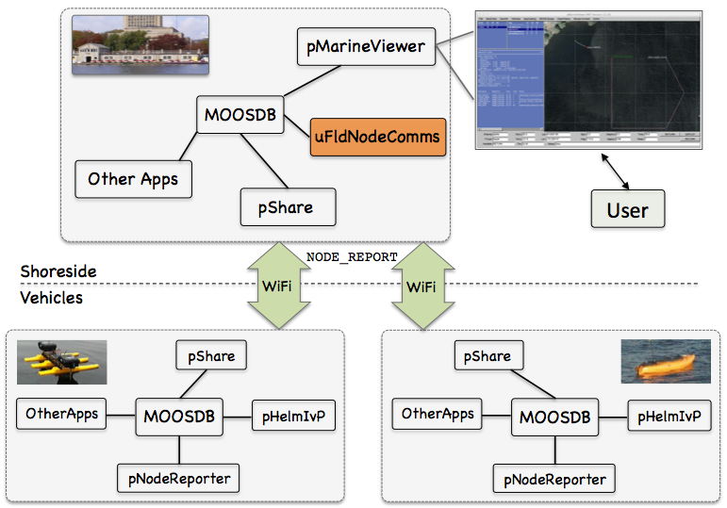
The uFldNodeComms App Typical Application Toplogy
The uFldNodeComms app runs on the shoreside, limits intervehicle messaging.

Slide 55
The uFldNodeComms App Typical Application Toplogy
The uFldNodeComms configuration parameters:
Distance in meters between vehicles
ProcessConfig = uFieldNodeComms
{
COMMS_RANGE = 200
MIN_MSG_INTERVAL = 60
MAX_MSG_LENGTH = 100
}
Min time between messages from a vehicle
Max chars in a string message
In Lab 09 we will configure uFieldNodeComms:
COMMS_RANGE = 100 // Must be within 100 meters of the other vehicle
MIN_MSG_INTERVAL = 0 // Messaging as often as desired
MAX_MSG_LENGTH = 0 // Signifies unlimited length

Slide 56
More Lab 09 Preview Inter-vehicle Messaging
In the first part of today’s lab, we will build a simple two-vehicle mission:
Each vehicle is loitering in it’s half of an east-west op-area.
Each vehicle periodically sends a message to the other vehicle to switch its region

Slide 57
More Lab 09 Preview Inter-vehicle Messaging
This video can be found on the course wiki video page under lab #9 as clip #91:
http://18.38.2.158/2.680/clips/clip_91_simple_messaging.m4v

Slide 58
END

