Slide 1
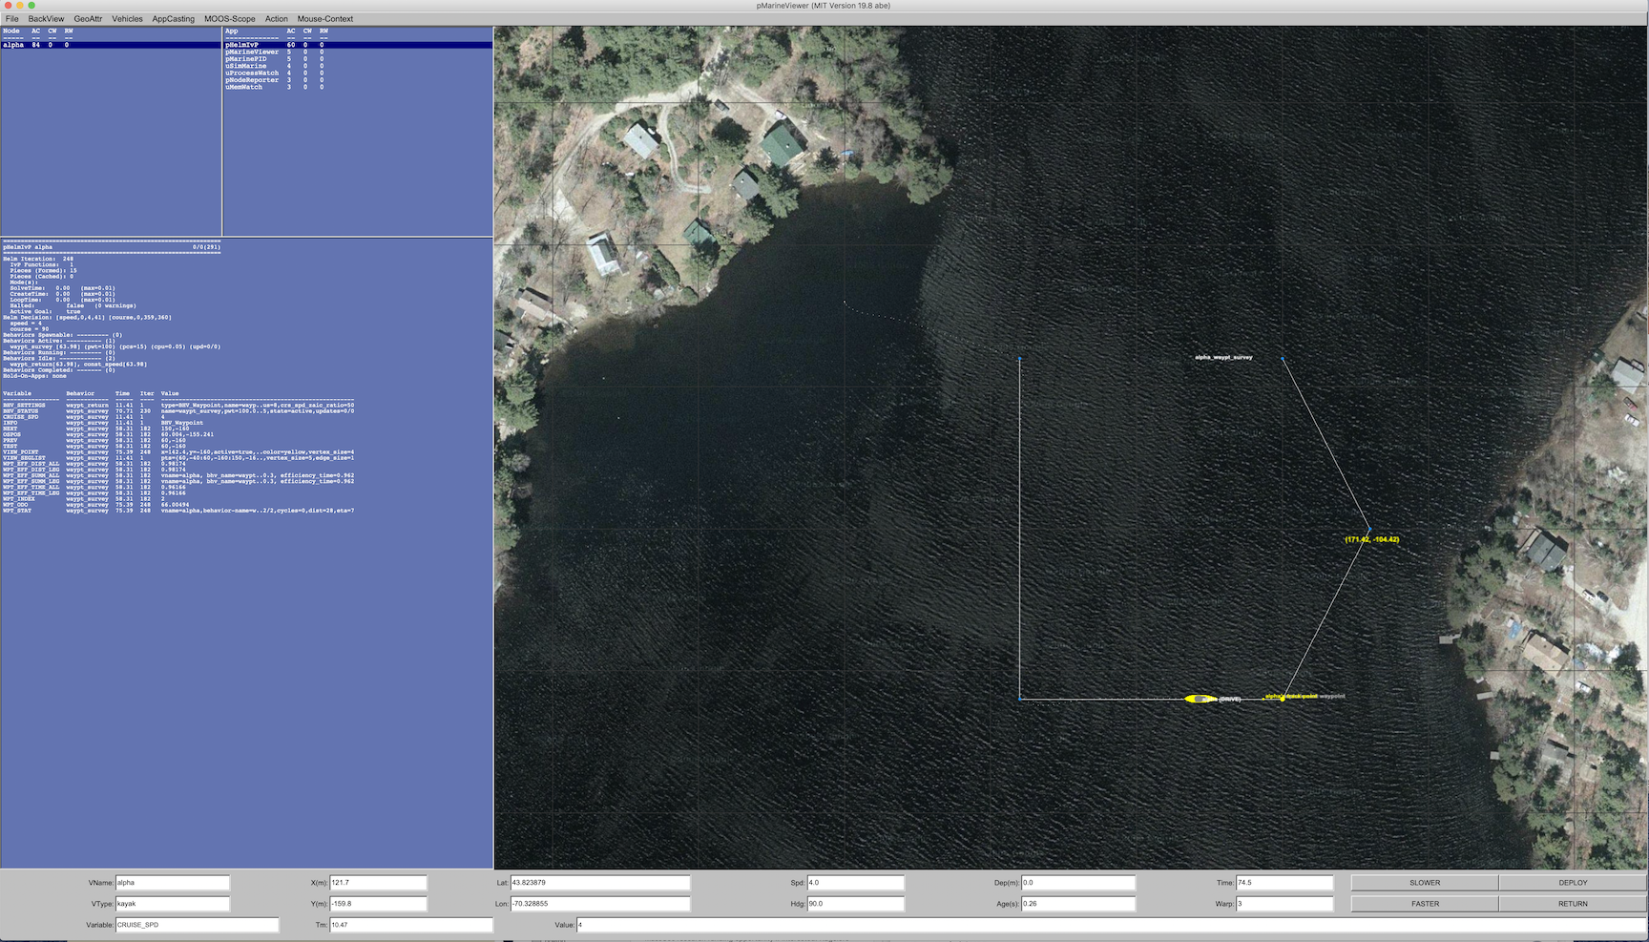
Host Computer
Container
Outgoing Port
Processes Simulating
an
Autonomous Vehicle
Command and Control
Processes and GUI
Incoming Port

Slide 2
Host Computer
Container
Outgoing Port
Processes Simulating
an
Autonomous Vehicle
Incoming Port
Command and Control
Processes and GUI

Slide 3
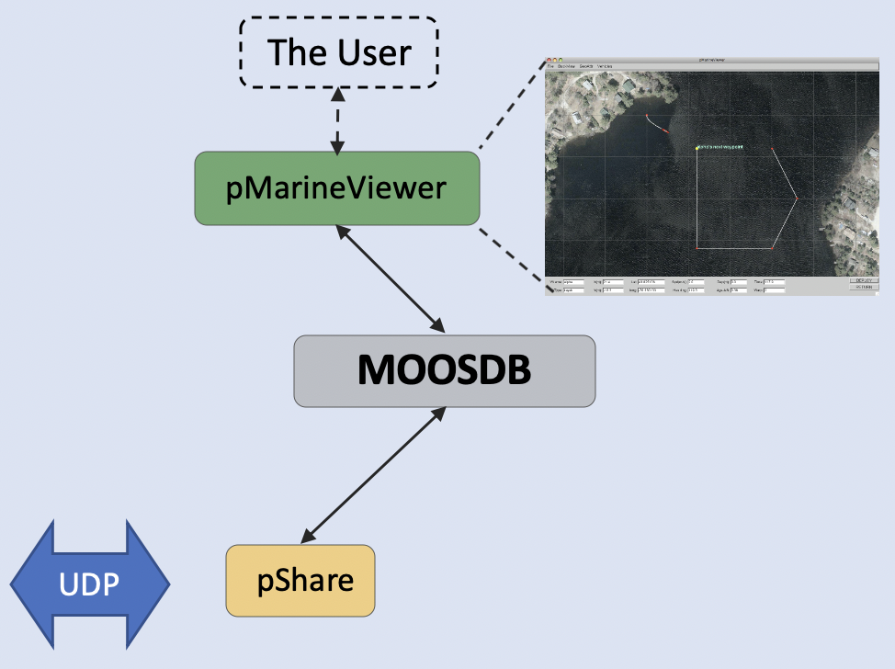
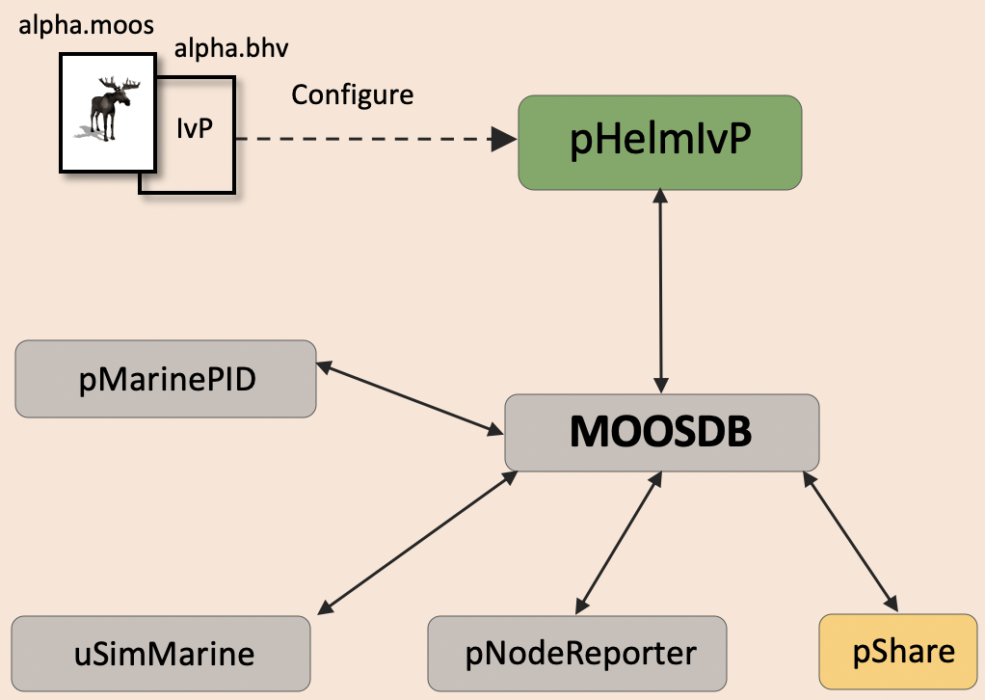
Host Computer
Container
Outgoing Port
Incoming Port

Slide 4
Host Computer
Container
Outgoing Port
Processes Simulating
an
Autonomous Vehicle
Command and Control
Processes and GUI
Incoming Port

Slide 5
Simulation Computer
alpha.moos
alpha.bhv
Configure
IvP
pHelmIvP
1
2
pMarinePID
MOOSDB
3
4
5
uSimMarine
pNodeReporter
pMarineViewer
The User

Slide 6
Robot Computer
Shoreside Computer
alpha.moos
alpha.bhv
Configure
The User
IvP
pHelmIvP
pMarineViewer
pMarinePID
MOOSDB
MOOSDB
UDP
uSimMarine
pNodeReporter
pShare
pShare

Slide 7
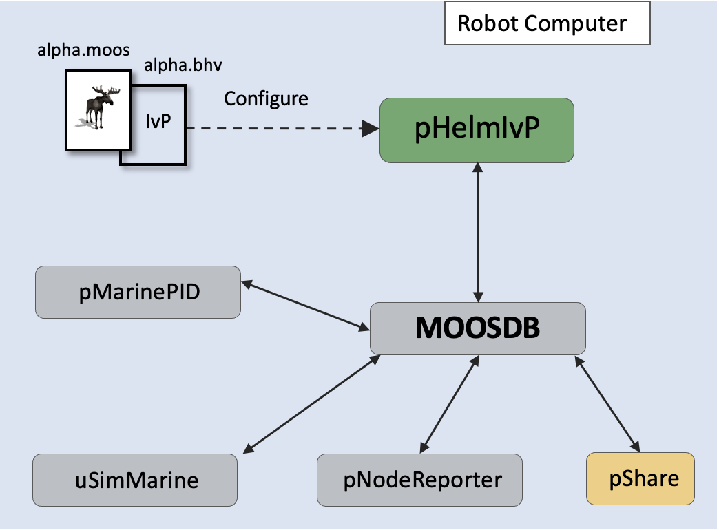
3 Robots - 3 Containers
Shoreside Computer
The User
UDP
pMarineViewer
UDP
MOOSDB
UDP
pShare

Slide 8
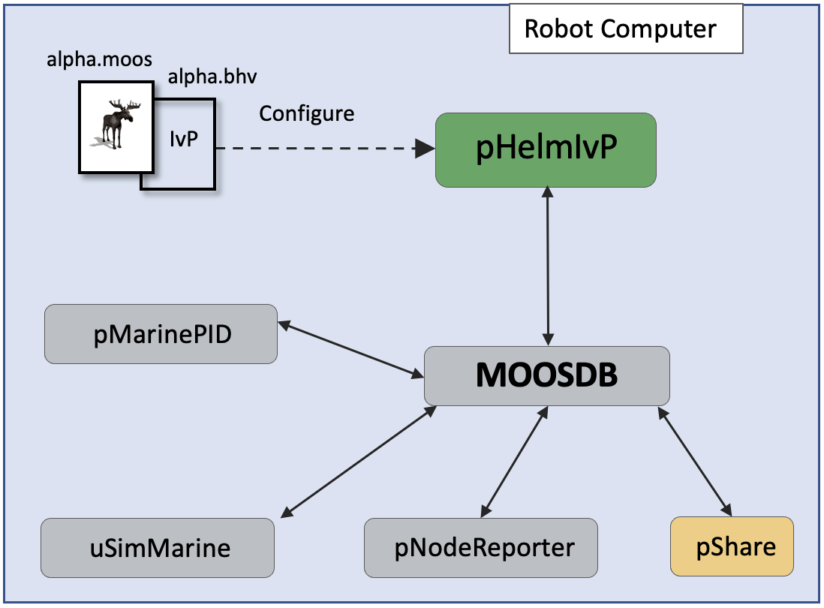
Shoreside Computer
UDP
The User
UDP
pMarineViewer
UDP
MOOSDB
UDP
pShare

Slide 9
Shoreside Computer
UDP
The User
UDP
pMarineViewer
UDP
MOOSDB
UDP
pShare

Slide 10
alpha.moos
alpha.bhv
Configure
The User
IvP
pHelmIvP
pMarineViewer
pMarinePID
MOOSDB
MOOSDB
uSimMarine
pNodeReporter
pShare
UDP
pShare

Slide 11
Container
Running
Stopped
Exited
Dead
Image
Container
Running
Stopped
Exited
Dead
Container
Running
Stopped
Exited
Dead

