Slide 1
Main Vehicle
Computer
Battery
E-Stop
IMU
GPS Receiver

Slide 2
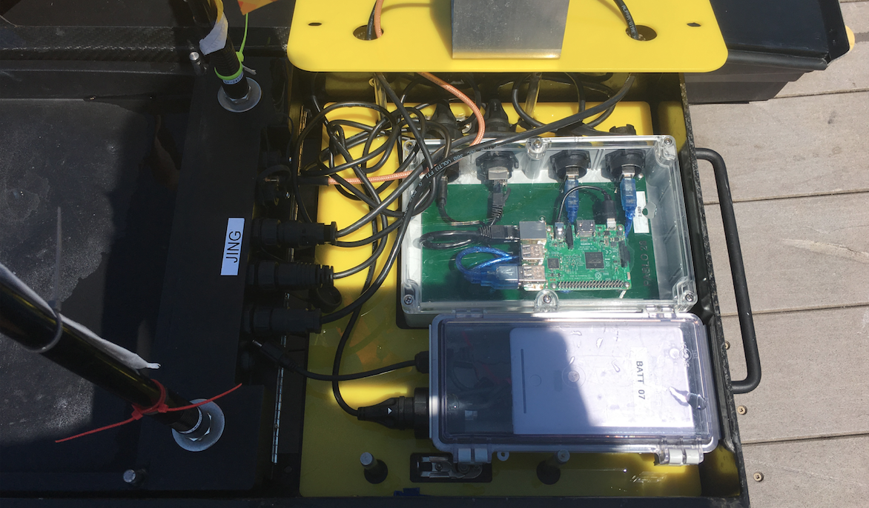
The PABLO Payload
Autonomy Box
Payload components
Template plate
Dedicated PABLO
Power Supply

Slide 3
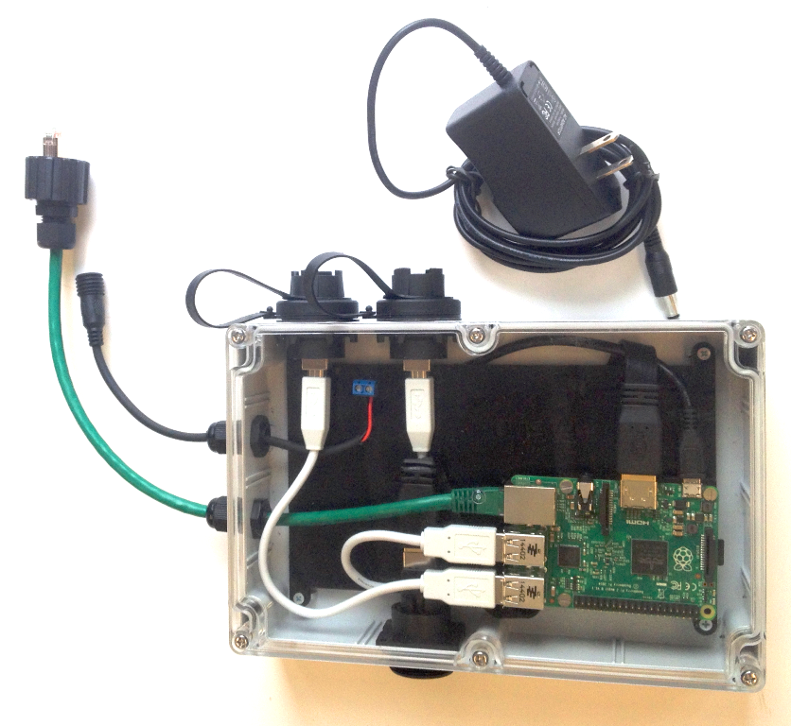

Slide 4
(a) 192.168.1.173
(c) 192.168.14.100
Heron
Front-seat
Computer
Payload
Computer
(PABLO)
(b) 192.168.14.1

Slide 5
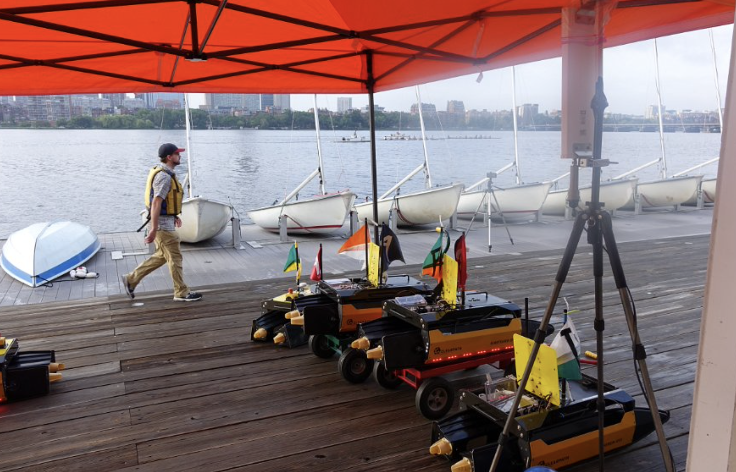

Slide 6
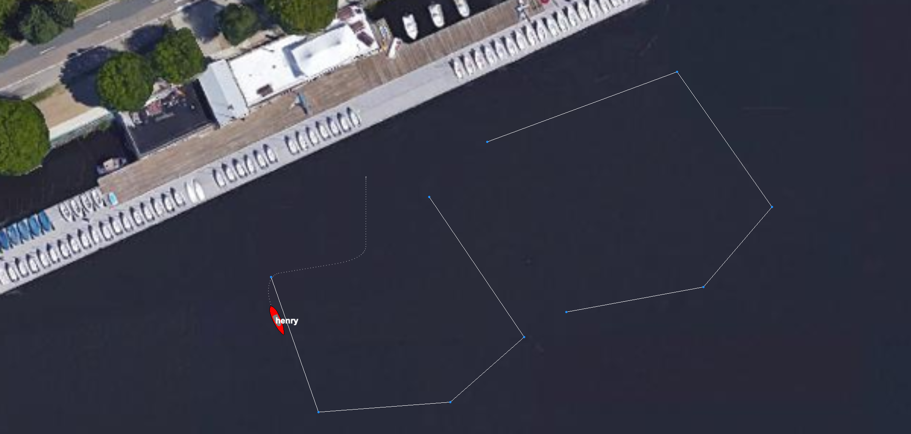
East
West

