Slide 1
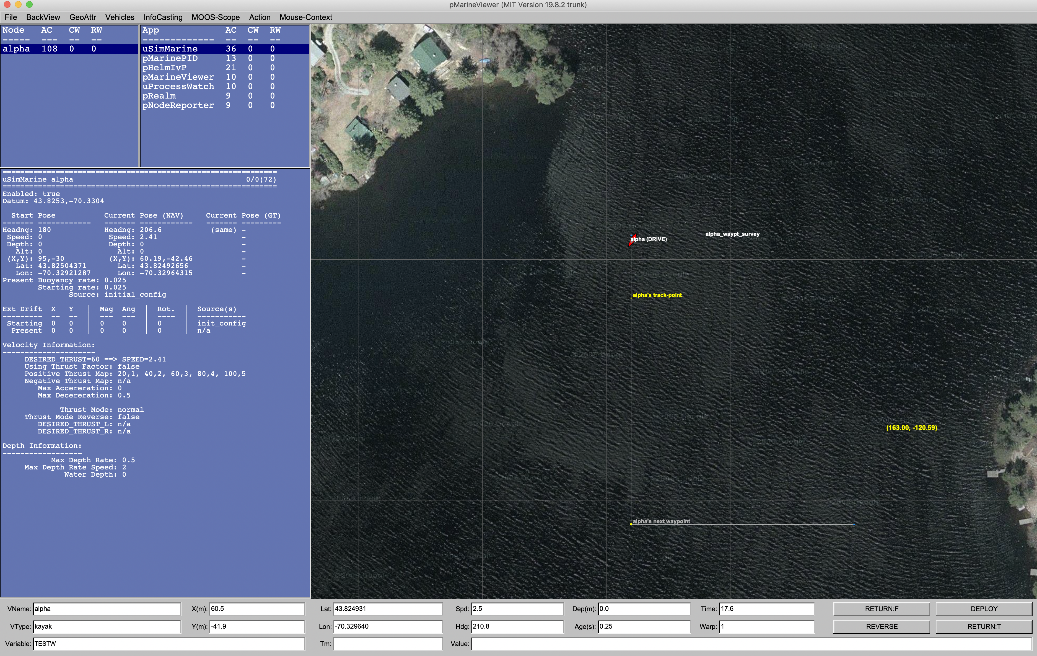
Shoreside Community
pMarineViewer
MOOSDB
Other Apps …
User / Command and Control
pShare
Vehicle Community
Vehicle Community
pShare
pShare
MOOSDB
Other Apps …
Other Apps …
MOOSDB
pHelmIvP
pHelmIvP

Slide 2
pXRelay_Apples
pXRelay_Pears
MOOSDB

Slide 3
Apples
MOOS Community
Pears
MOOS Community
pShare
pShare
pXRelay
MOOSDB
MOOSDB
pXRelay

Slide 4
Apples
MOOS Community
Pears
MOOS Community
input = route = localhost:9200
pShare
pShare
input = route = localhost:9201
output = src=APPLES, route=localhost:9201
output = src=PEARS, route=localhost:9200
pXRelay
MOOSDB
MOOSDB
pXRelay

