Slide 1
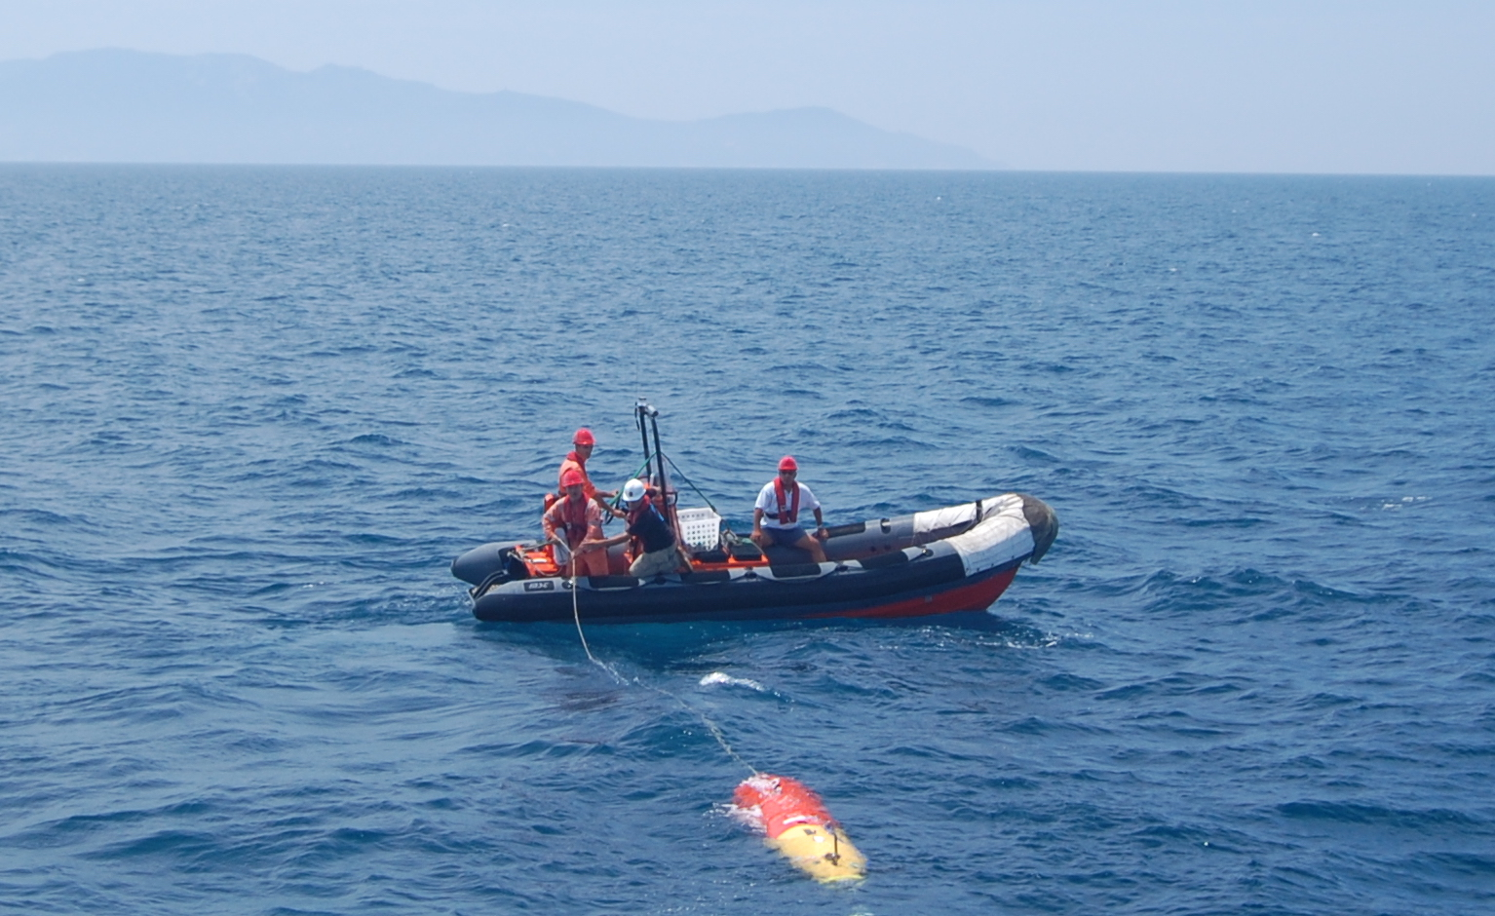
Accelerated Marine Vehicle Autonomy,
Sensing, and Communications
Fall 2017
Schlumberger-Doll Research
Cambridge MA

