Slide 1
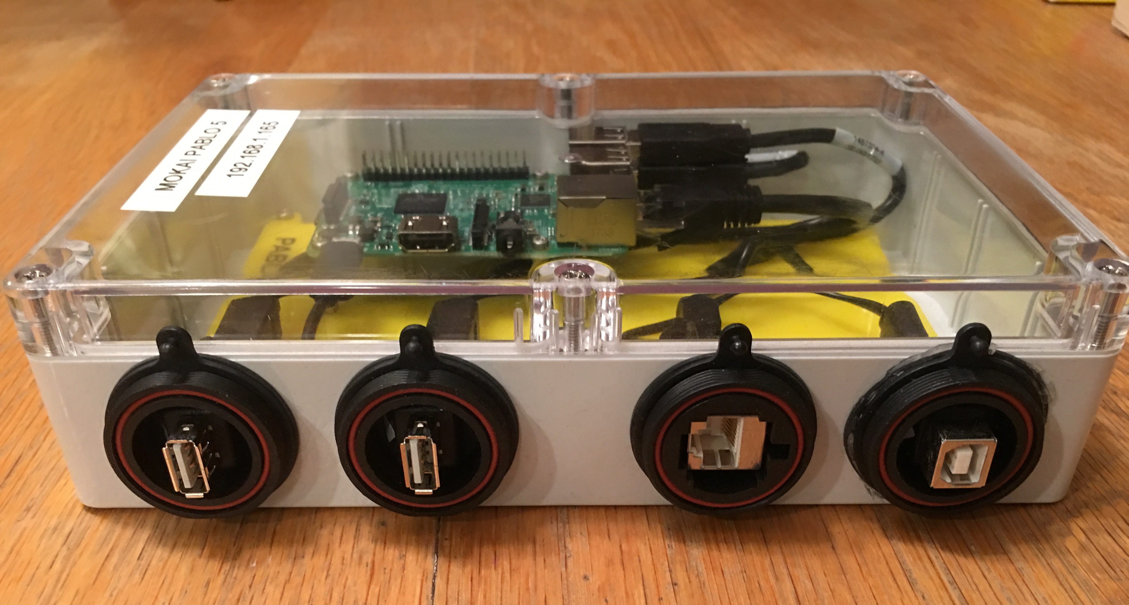
pablo
USB
USB
Ethernet
Power

