Slide 1
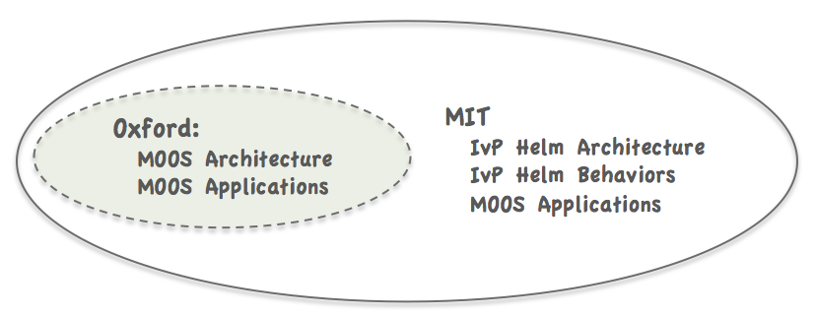
Unrestricted (public domain)
List of Developed MOOS Modules
(152 Modules)
Collaborations (user-to-user)
Oxford MOOS tree
The moos-ivp tree
MOOSDB
pLogger
iRemote
pScheduler
pShare
pMOOSBridge
umm
uMS
iMatlab
pAntler
uPlayback
pNodeReporter
uProcessWatch
uSimCurrent
uLogViewHelm
uTermCommand
pBasicContactMgr
alogclip
aloggrep
alogscan
uLoadWatch
uFldWrapDetect
uXMS
uFunctionVis
uTimerScript
pHostInfo
geoview
nsplug
alogrm
aloghelm
alogview
alogiter
iSay
uFldMessageHandler
uFldContactRangeSensor
uFldBeaconRangeSensor
uFldHazardSensor
uFldHazardMetric
uFldCollisionDetect
uFldPathCheck
uFldNodeComms
uFldNodeBroker
uFldShoreBroker
uFldScope
pHelmIvP
pMarinePID
uSimMarine
pMarineViewer
pEchoVar
uLogView
uLogViewIPF
uHelmScope
uPokeDB
uMAC
uMACView

Slide 2
Unrestricted (public domain)
List of Developed MOOS Modules
(152 Modules)
Collaborations (user-to-user)
Your Apps
Your Behaviors
Oxford MOOS tree
The moos-ivp tree
moos-ivp-extend tree
MOOSDB
pLogger
iRemote
pScheduler
pShare
pMOOSBridge
umm
uMS
iMatlab
pAntler
uPlayback
pNodeReporter
uProcessWatch
uSimCurrent
uLogViewHelm
uTermCommand
pBasicContactMgr
alogclip
aloggrep
alogscan
uLoadWatch
uFldWrapDetect
uXMS
uFunctionVis
uTimerScript
pHostInfo
geoview
nsplug
alogrm
aloghelm
alogview
alogiter
iSay
uFldMessageHandler
uFldContactRangeSensor
uFldBeaconRangeSensor
uFldHazardSensor
uFldHazardMetric
uFldCollisionDetect
uFldPathCheck
uFldNodeComms
uFldNodeBroker
uFldShoreBroker
uFldScope
pHelmIvP
pMarinePID
uSimMarine
pMarineViewer
pEchoVar
uLogView
uLogViewIPF
uHelmScope
uPokeDB
uMAC
uMACView
Your MOOS Apps
Your Helm Behaviors

