Slide 1
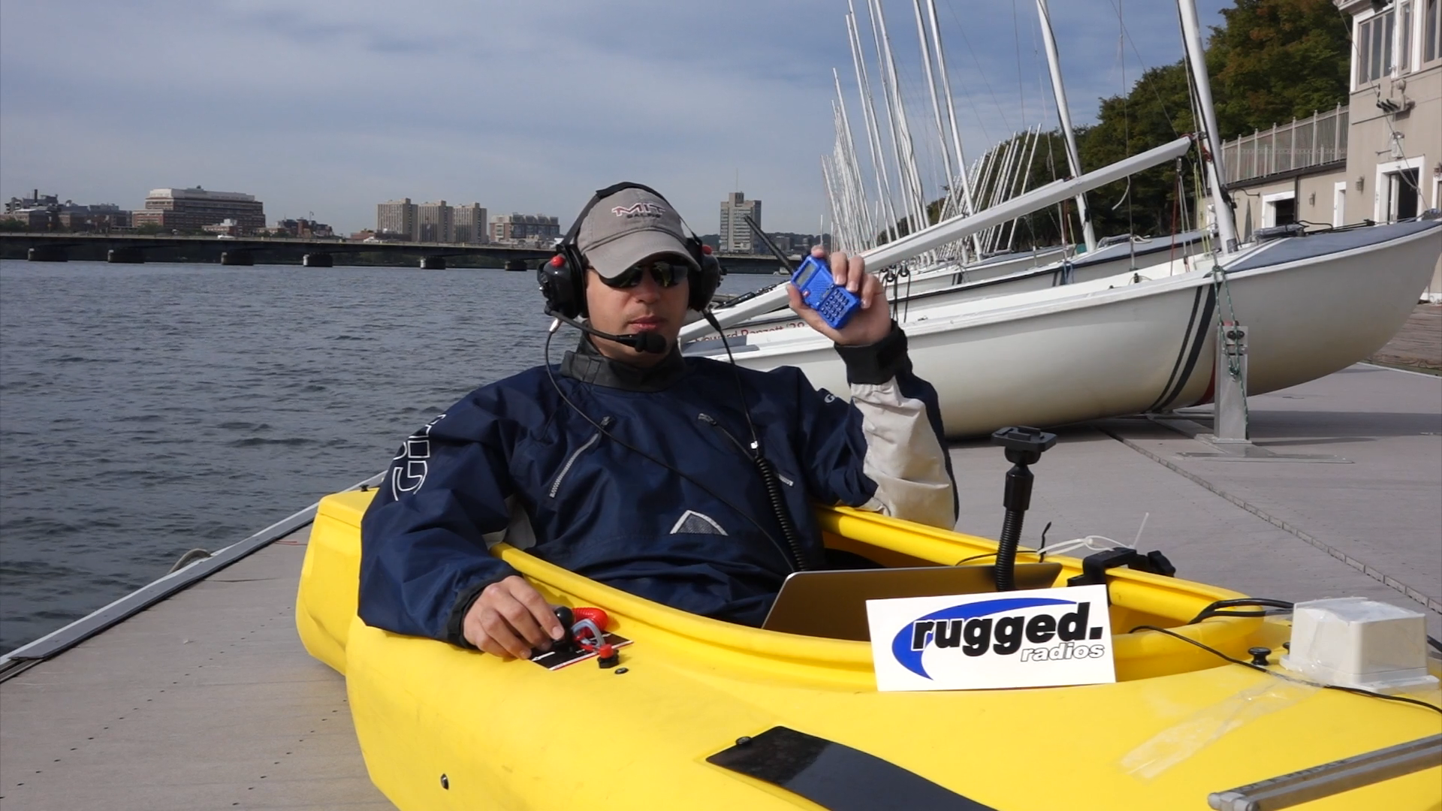
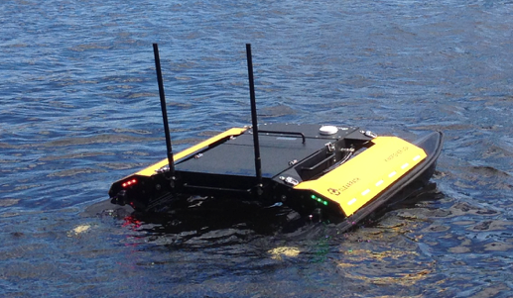
pMarineViewer
uFldFlagManager
MOOSDB
pHostInfo
uFldTagManager
pShare
Referee
Shoreside
NODE_REPORT
Vehicles
WiFi
WiFi
pShare
pShare
uSpeechRec
pNodeReporter
MOOSDB
pFlagStrategy
MOOSDB
pHelmIvP
iSay
uDialogManager
pNodeReporter
pBotDialog

