Slide 1
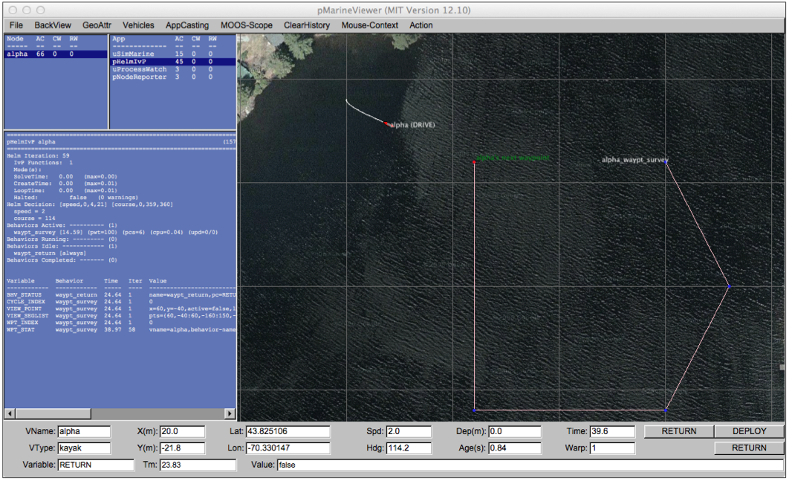
pMarineViewer
MOOSDB
uFldTagManager
Other Apps
pShare
User
Shoreside
FLAG_GRAB_REQUEST
FLAG_GRAB_REPORT
Vehicles
WiFi
WiFi
pShare
pShare
MOOSDB
pHelmIvP
MOOSDB
iJoyStick
pNodeReporter
pNodeReporter

