Slide 1
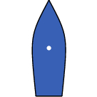
Enounter
Near Miss
Obstacle
Collision

