Slide 1

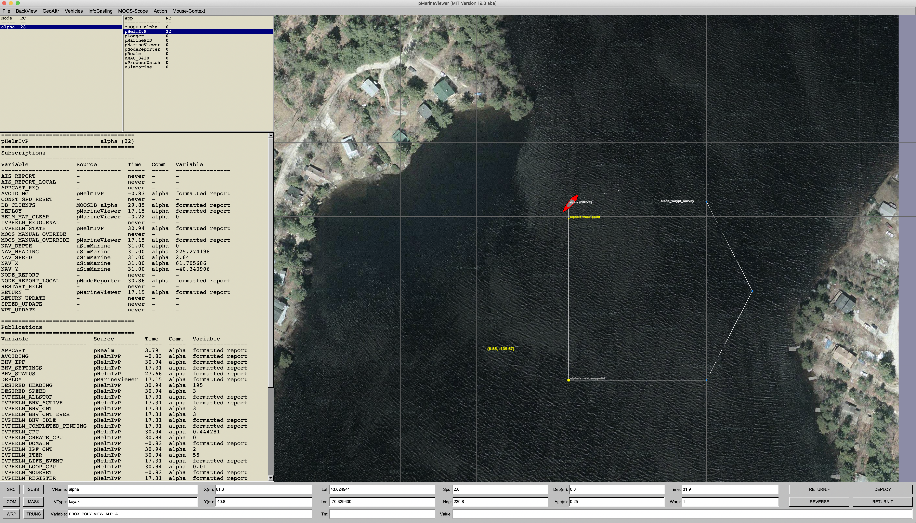
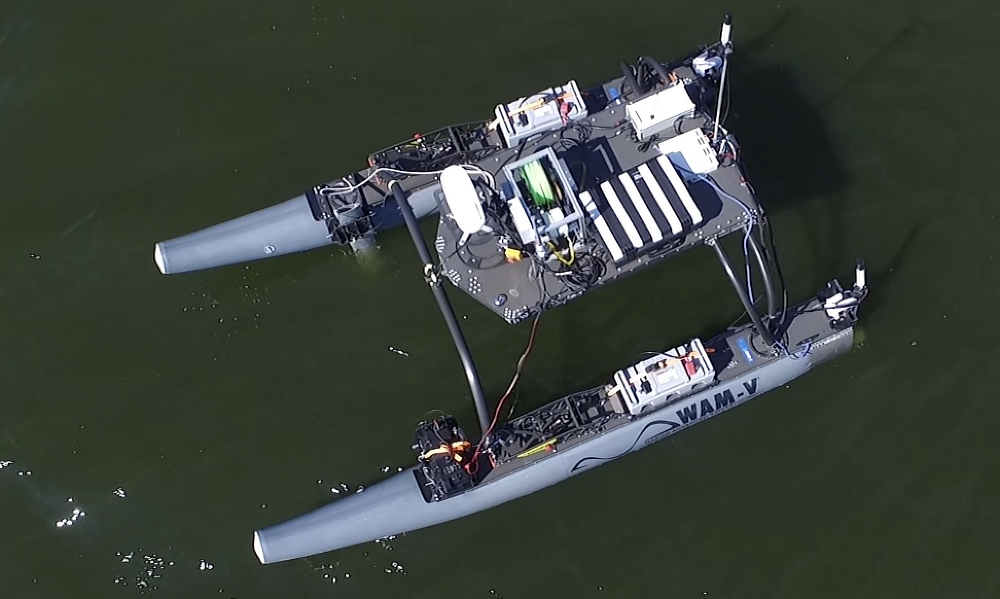
pMarineViewer
MOOSDB
pSpoofNode
Other Apps
pShare
uFldShoreBroker
User
Shoreside
Vehicles
pShare
pShare
OtherApps
MOOSDB
pHelmIvP
OtherApps
MOOSDB
pHelmIvP
pNodeReporter
pContactMgrV22
pNodeReporter
pContactMgrV22

