Slide 1
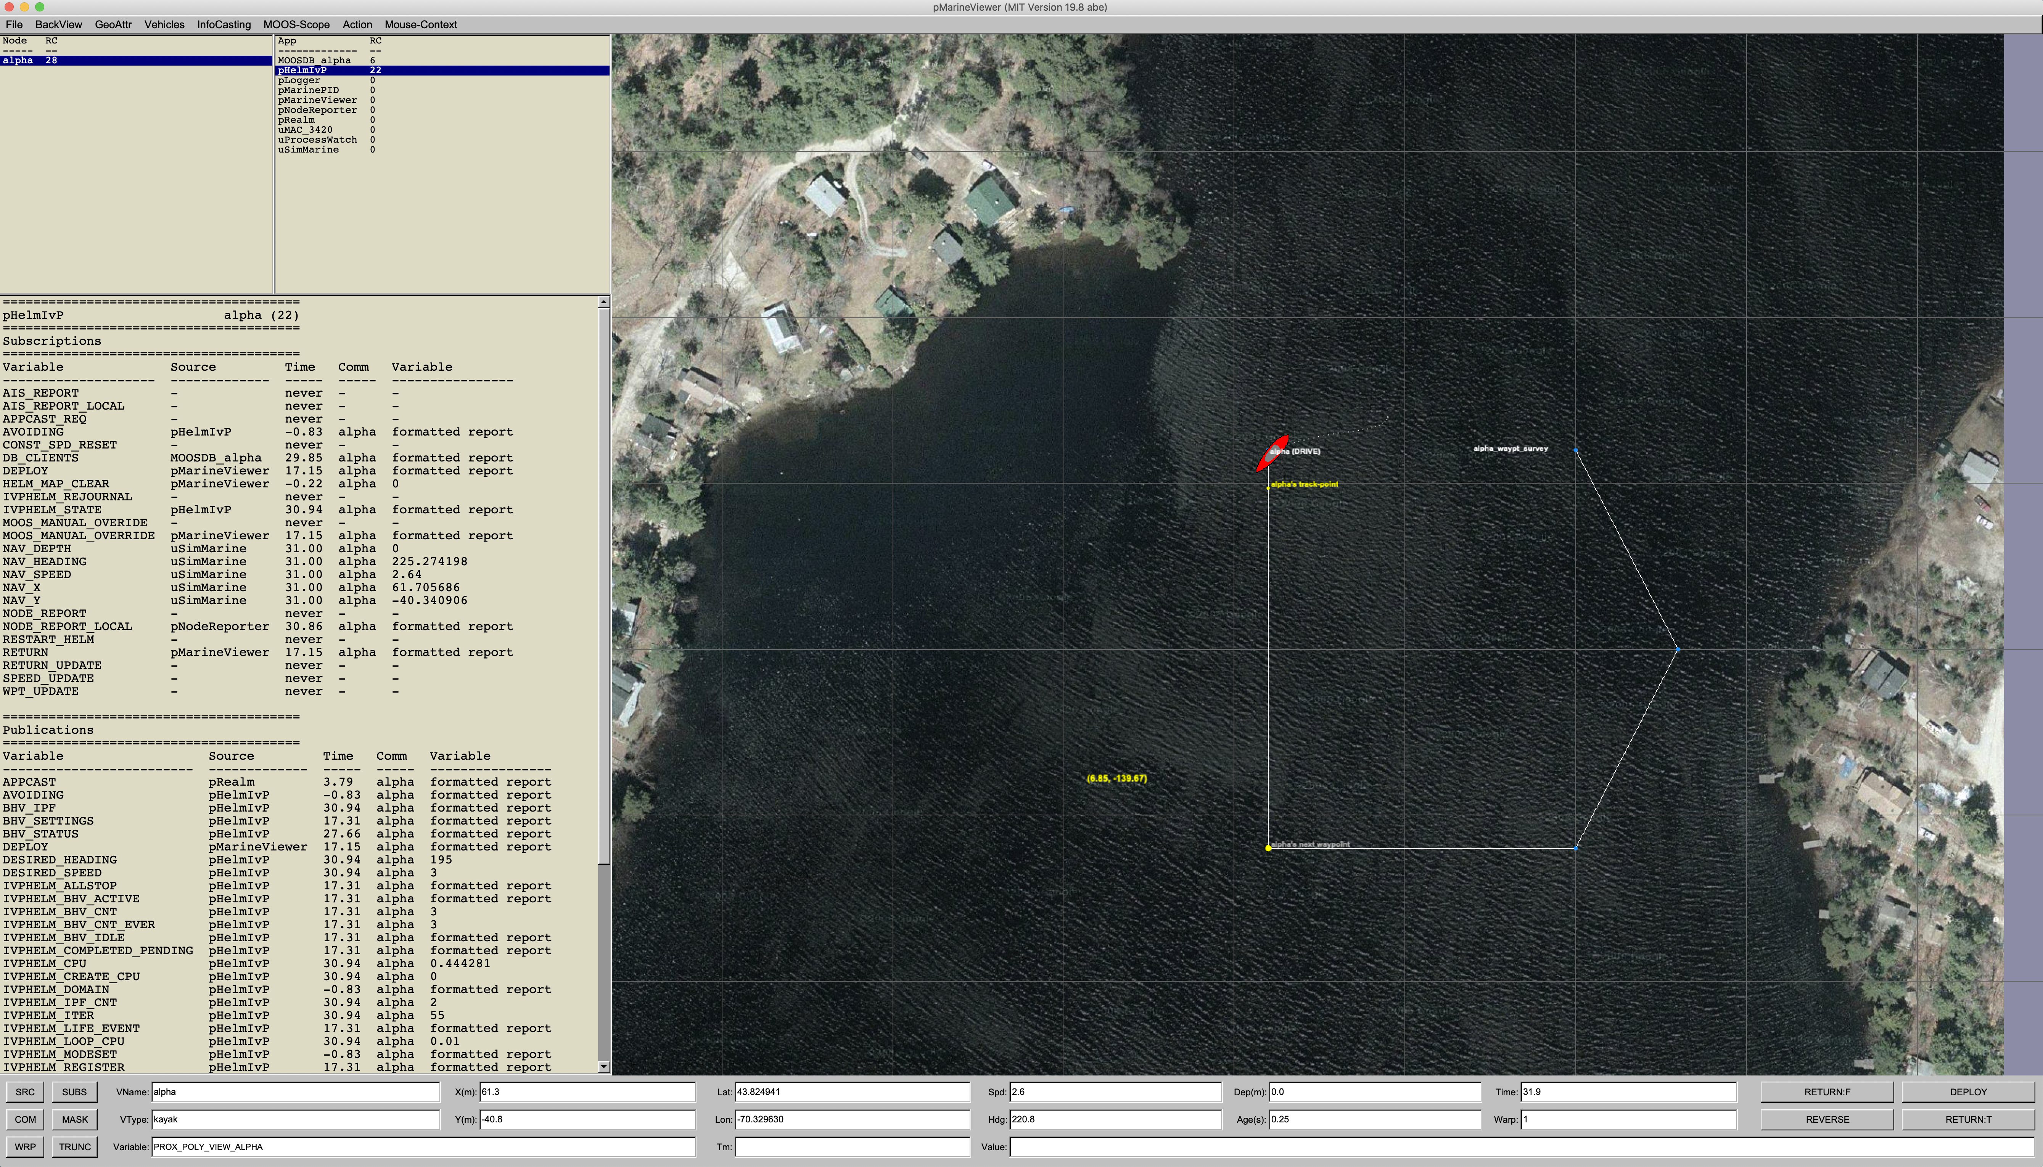
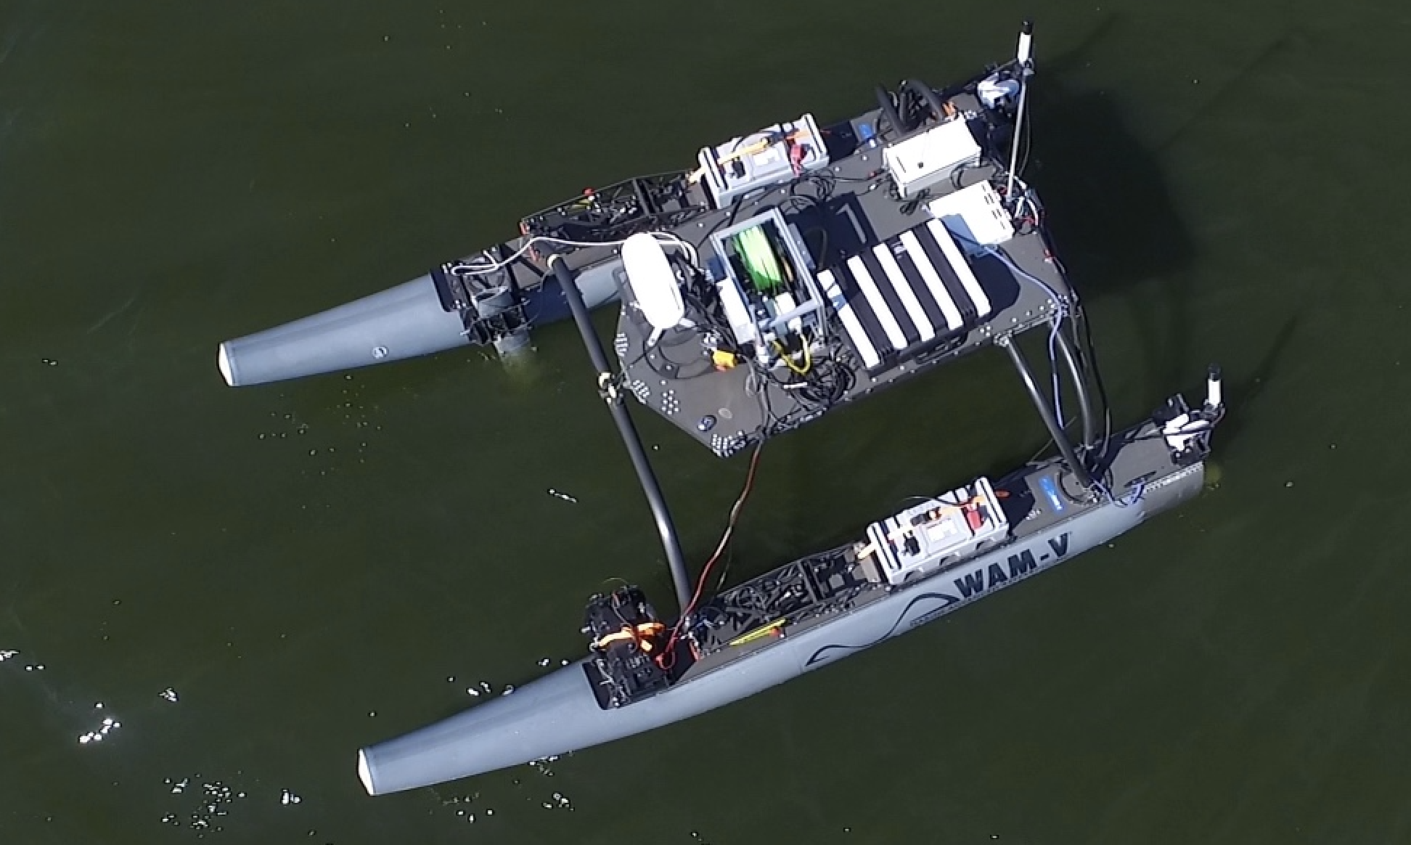
pMarineViewer
MOOSDB
pRealm
Other Apps
pShare
User
Shoreside
REALMCAST_REQ
REALMCAST
REALMCAST_CHANNELS
Vehicles
pShare
pShare
OtherApps
MOOSDB
pHelmIvP
OtherApps
MOOSDB
pHelmIvP
pNodeReporter
pRealm
pNodeReporter
pRealm

Slide 2
Requests should be registered locally in pRealm per request type. This way if there are multiple clients connected, wanting to look at different channels, then the clients can avoid changing channels on each other.
REALMCAST_REQ = “client=pmv,proc=pNodeReporter,duration=5”
REALMCAST_REQ
Client
pRealm
REALMCAST
REALMCAST = “node=ben!Q!proc=pNodeReporter!Q!count=22!Q!...”

Slide 3
Requests should be registered locally in pRealm per request type. This way if there are multiple clients connected, wanting to look at different channels, then the clients can avoid changing channels on each other.
REALMCAST_REQ = “client=pmv,duration=5,vars=DEPLOY:RETURN”
REALMCAST_REQ
Client
pRealm
WATCHCAST
WATCHCAST = “node=ben!X!var=DEPLOY!X!src=pHelmIvP!X!comm=ben!X!loc_time=1.45!X!....”
WATCHCAST = “node=ben!X!var=RETURN!X!src=pHelmIvP!X!comm=ben!X!loc_time=1.47!X!....”

Slide 4
Requests should be registered locally in pRealm per request type. This way if there are multiple clients connected, wanting to look at different channels, then the clients can avoid changing channels on each other.
Shoreside
Vehicle (henry)
Client
pRealm
REALMCAST_CHANNELS
REALMCAST_CHANNELS = “node=henry#channels=MOOSDB_henry,iSay, pContactMgrV20,pHelmIvP,pHostInfo,pLogger,pMarinePID,pNodeReporter,pRealm,pShare,uFldNodeBroker,uLoadWatch,uMemWatch,uProcessWatch,
uSimMarine”

Slide 5
