Slide 1
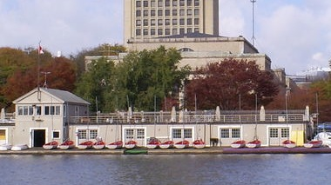
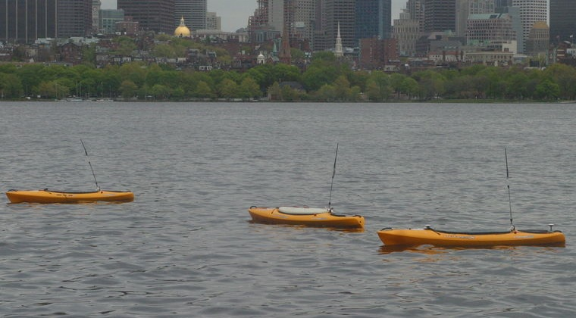
In-Field Topology
uFldHazardSensor
pMarineViewer
Hazard File
MOOSDB
Other Apps
pShare
UHZ_HAZARD_REPORT
UHZ_CONFIG_REQUEST
Shoreside
UHZ_CONFIG_ACK
Net
Work
UHZ_SENSOR_REQUEST
HAZARDSET_REQUEST
NODE_REPORT
Vehicles
HAZARDSET_REPORT
pShare
uFldHazardMgr
MOOSDB
pHelmIvP
pNodeReporter

