Slide 1
Optimizing Ops
Ian Katz
MIT Sea Grant
Autonomous Underwater Vehicles Laboratory
Presented at MOOS-DAWG August 24, 2010
Notes:
Hey everyone, just to introduce myself I’m ian katz

Slide 2
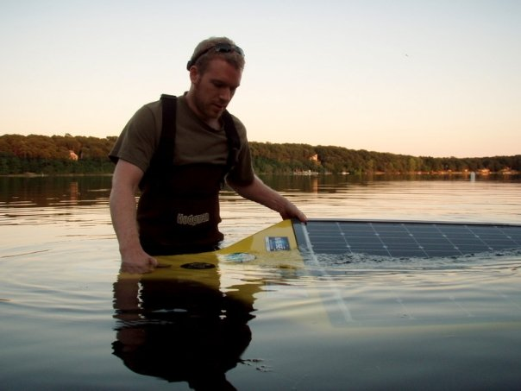
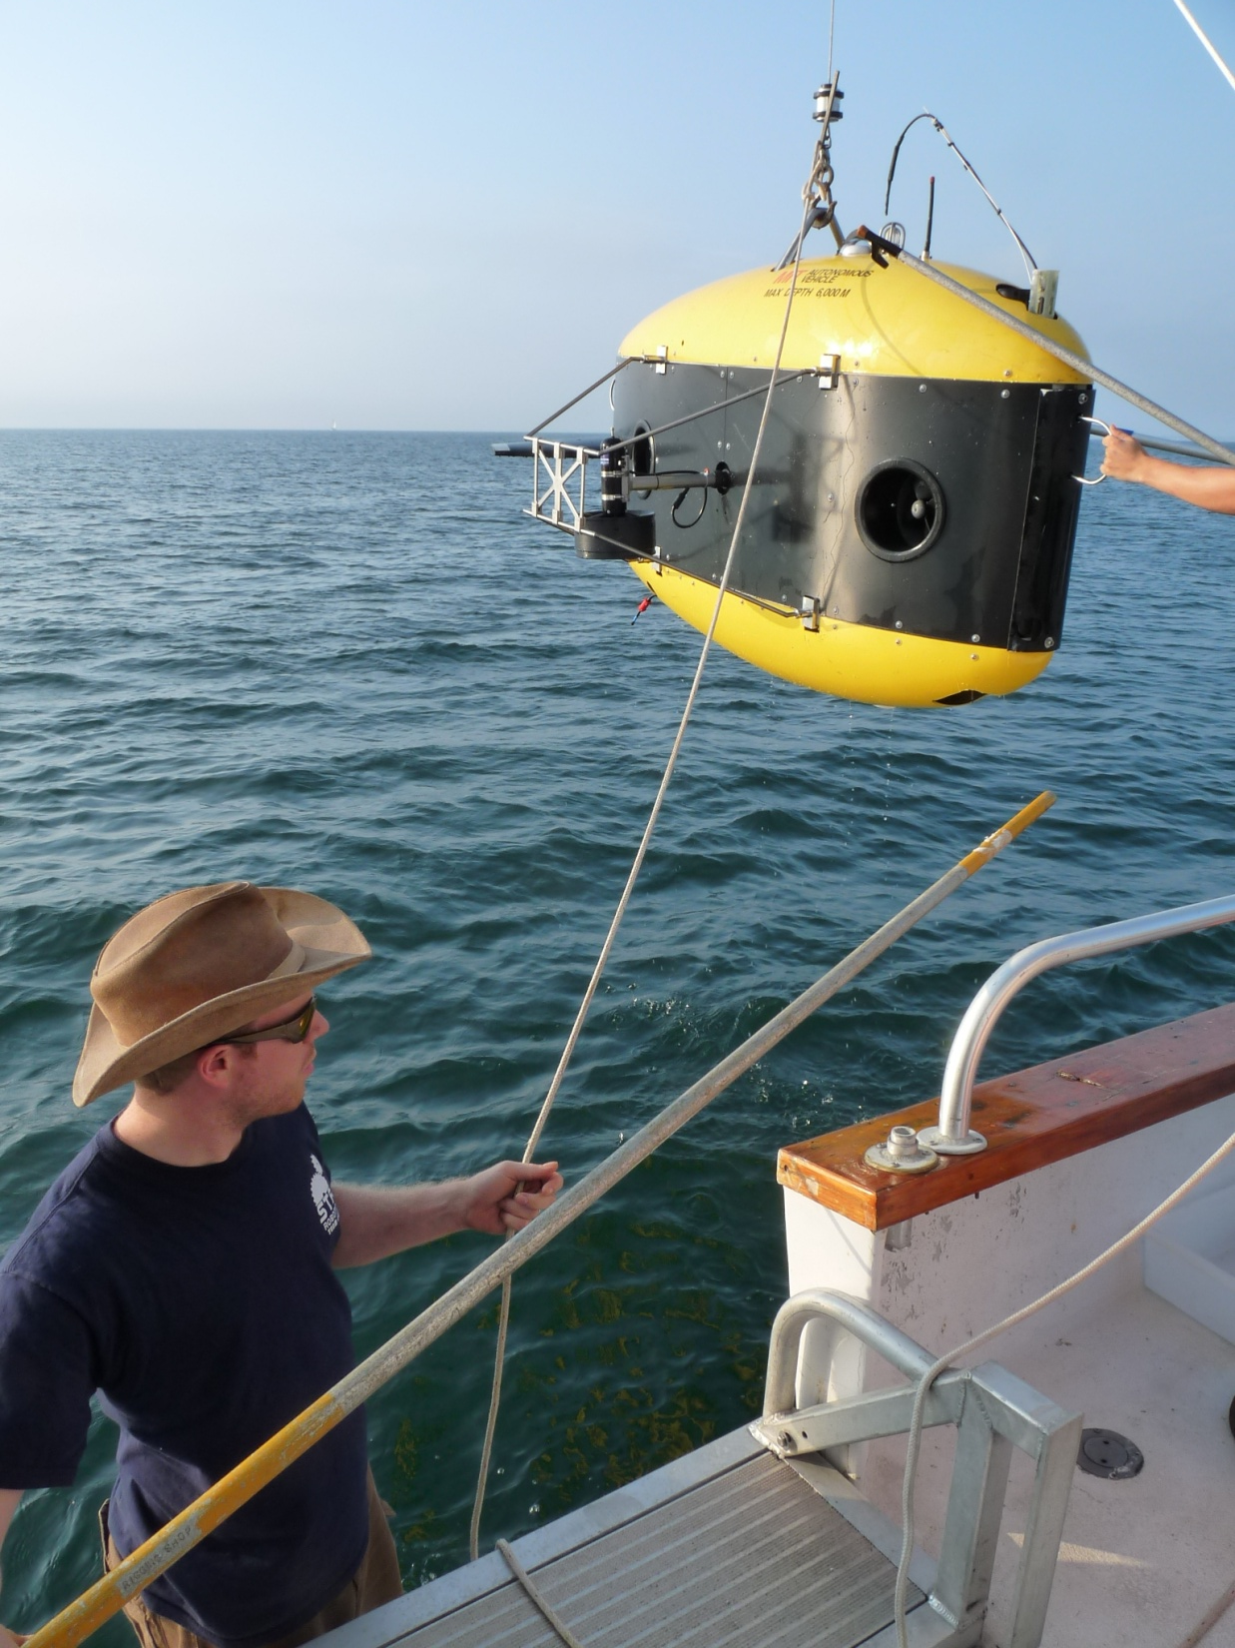
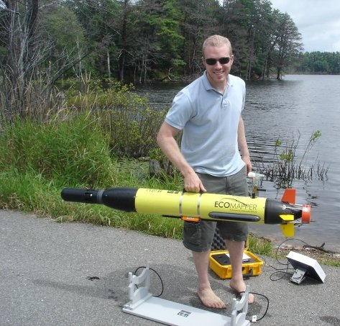
Since 2007
Notes:
I’ve been working on auvs for the past 4 years, which is an extension of

Slide 3
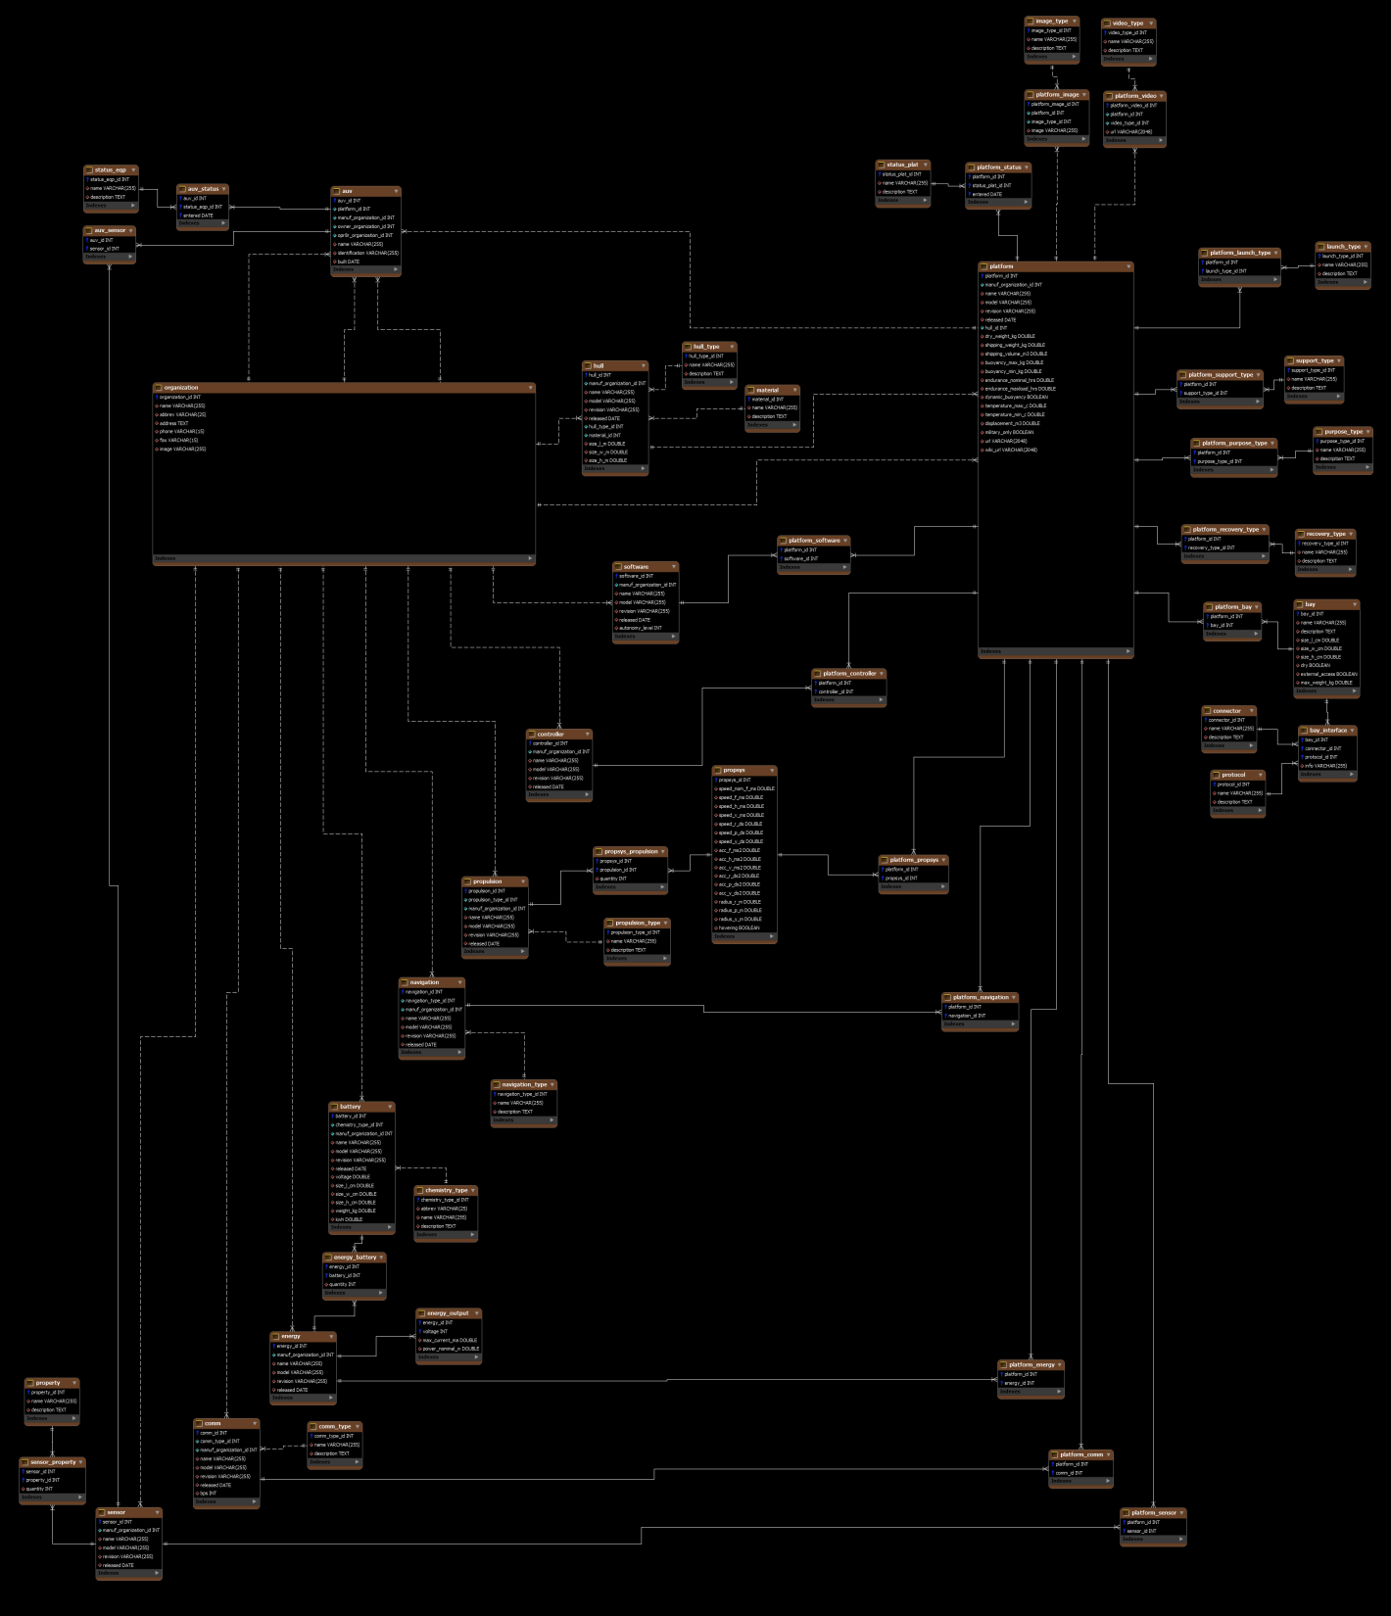
Since 2002
Automated Data Collection with Databases
Notes:
Automated data collection … which I’ve been doing for the past 8 years. And I’ll say off the bat that this talk will be light on implementation details, because (a) the code is available – this isn’t a how-to lecture and (b) at this point I don’t feel the need to establish “street cred” for doing what I do.

Slide 4
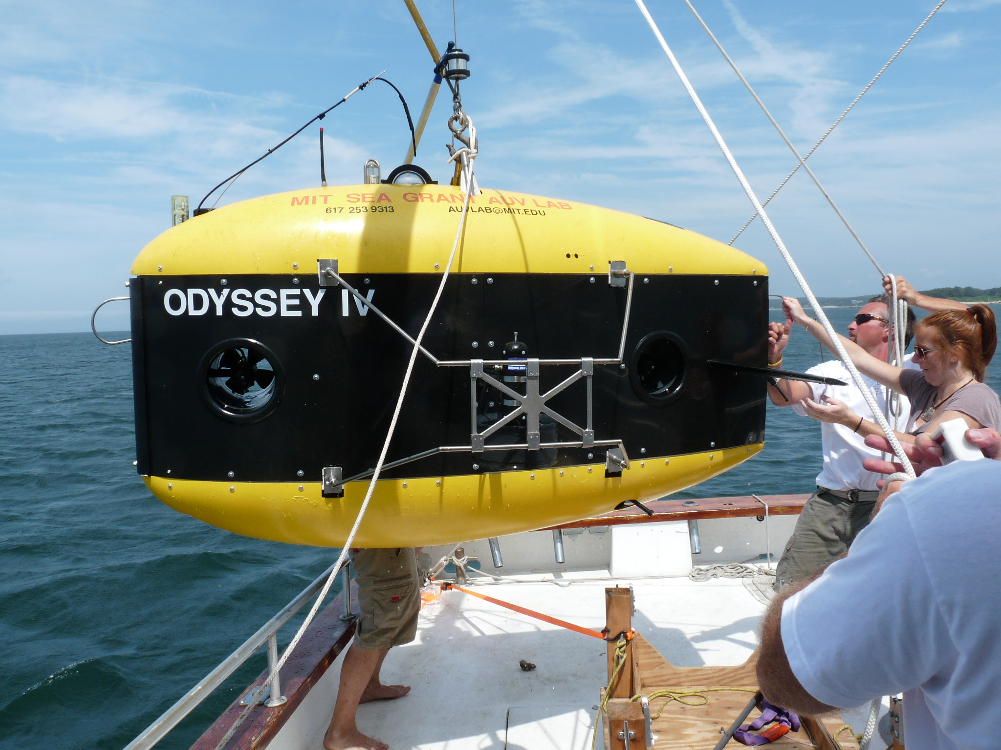
Notes:
This is the vehicle that I operate, so far my favorite automated data collection platform

Slide 5
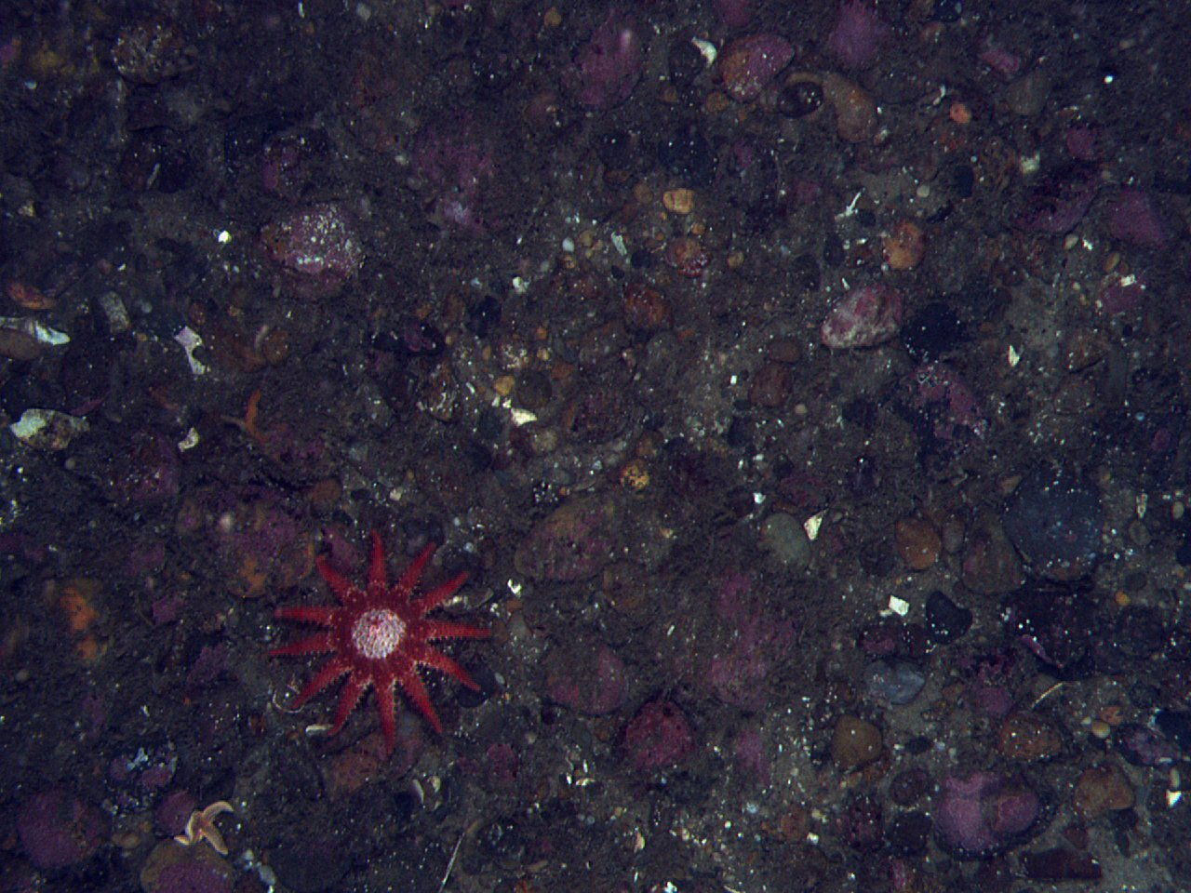
1. Look for proper bottom type 2. Lawnmower survey 3. Repeat
Our Process

Slide 6
What I’m going to talk about today

Slide 7
Time ≈ Money

Slide 8
Time ≈ Money
Notes:
Specifically, as it relates to time

Slide 9
1 second of boat ops ≈ 12¢
Notes:
Boat time is expensive. By my calculations, 12 cents every second.

Slide 10
Make the Most of Ops In 3 Ways:
Reduce mission envelope
Reduce intermission
Reduce error
Notes:
This are the 3 things I’m going to talk about today

Slide 11
“Mission envelope” and “intermission”? What are they?
(Besides terms that I made up)

Slide 12
Think of a mission
Check your environment
Tides
Depth
Location
Traffic
Configure mission and parameters
Pre-flight checks
Execute mission
Wait for completion
Post-flight checks
Analyze data
Move support vessel if necessary
Repeat
Notes:
Every mission is the same general series of steps. This will be different for you if you have ACOMMS, but these are ours

Slide 13
Mission Envelope
Think of a mission
Check your environment
Tides
Depth
Location
Traffic
Configure mission and parameters
Pre-flight checks
Execute mission
Wait for completion
Post-flight checks
Analyze data
Move support vessel if necessary
Repeat
Intermission
Notes:
The mission envelope starts when the operator knows what he wants to run, and ends when he turns on manual control. Everything between that and the next envelope is intermission.

Slide 14
Part 1
Reduce Mission Envelope

Slide 15
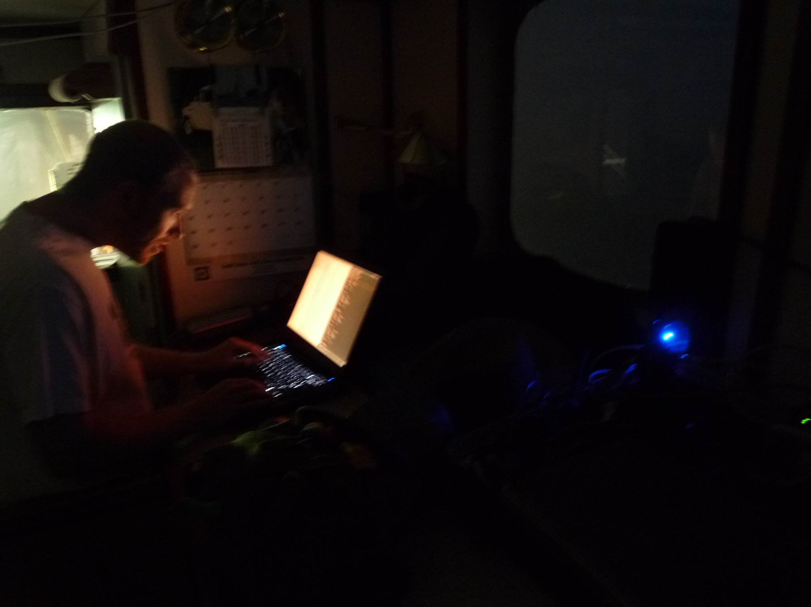
Don’t stare at a screen waiting for the AUV to surface
Notes:
The concept is simple: don’t stare at a screen…

Slide 16
Use audible alerts
Notes:
When you can have the computer alert you

Slide 17
Our Announcer: DiveOfficer
RF connectivity (AUV surfaced)
Mission status
Battery level
GPS connectivity

Slide 18
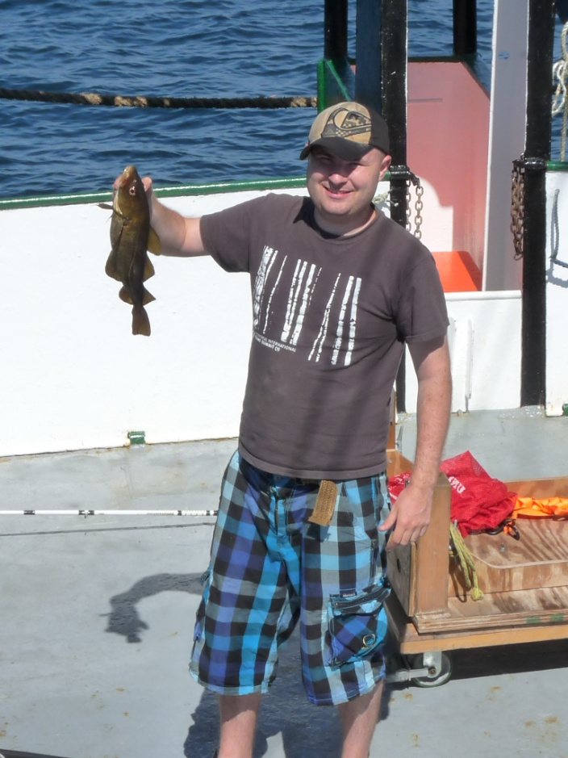
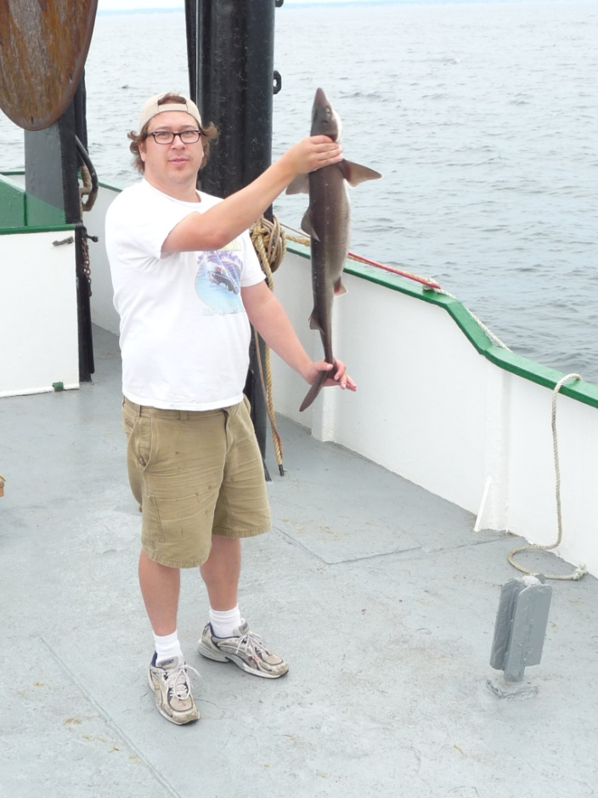
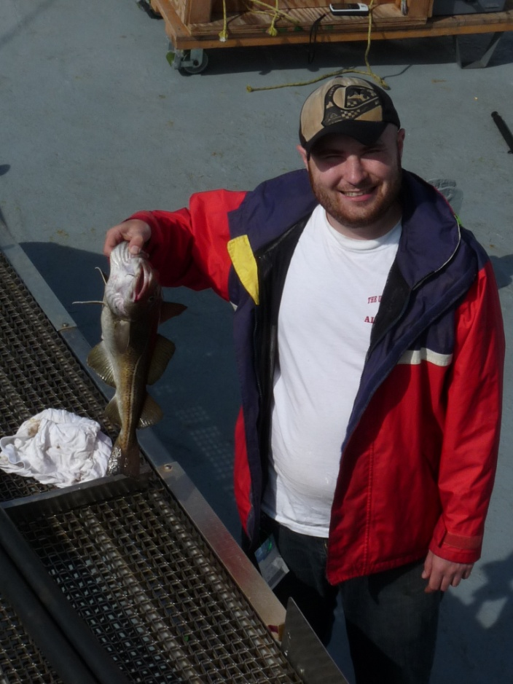
Freedom
to do other important work

Slide 19
DiveOfficer in Action

Slide 20
Getting GPS

Slide 21
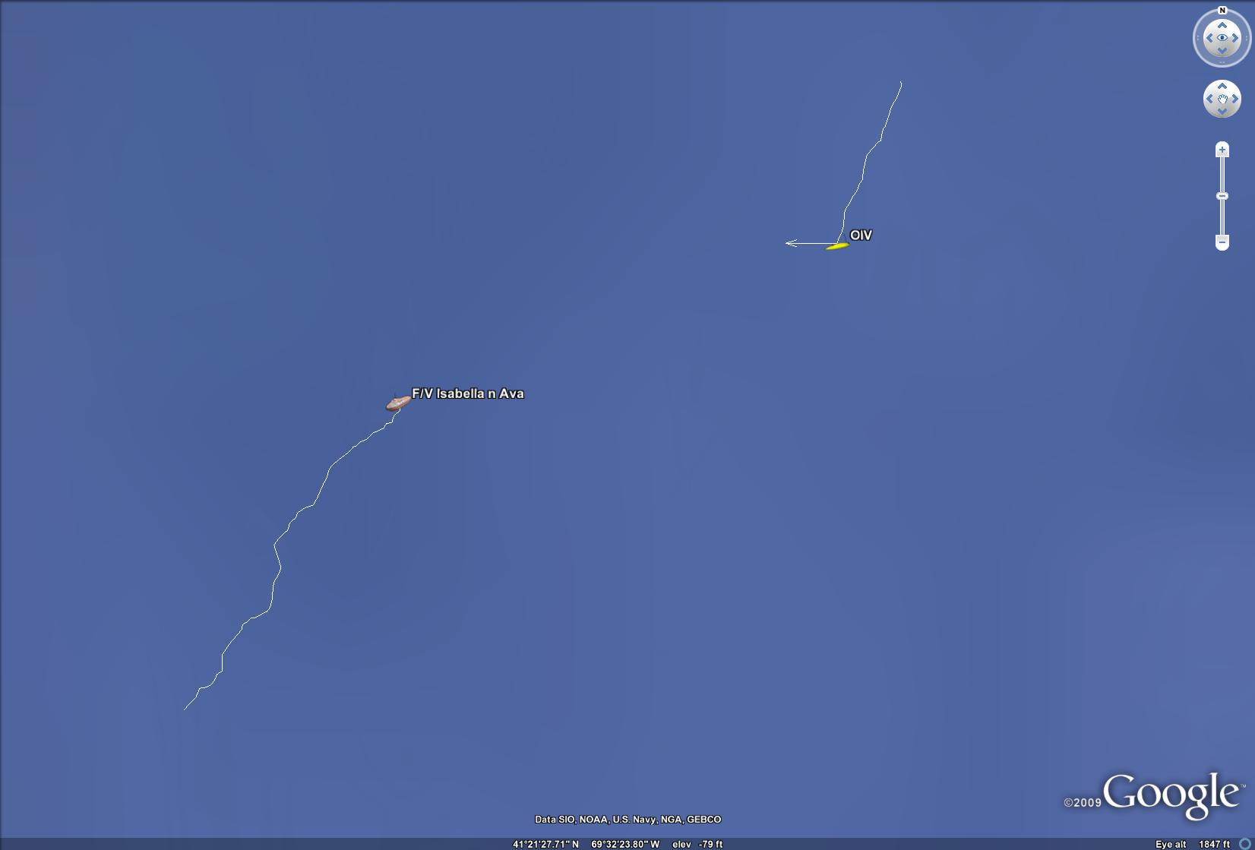
Google Earth: Vehicle Tracker
Read boat GPS via serial port, vehicle location via MOOS
Notes:
This brings me to my second tool for reducing mission envelope

Slide 22
Snail trails of the vehicles’ locations,
and their current heading
Notes:
Make sure the vehicle hasn’t popped up somewhere it shouldn’t

Slide 23
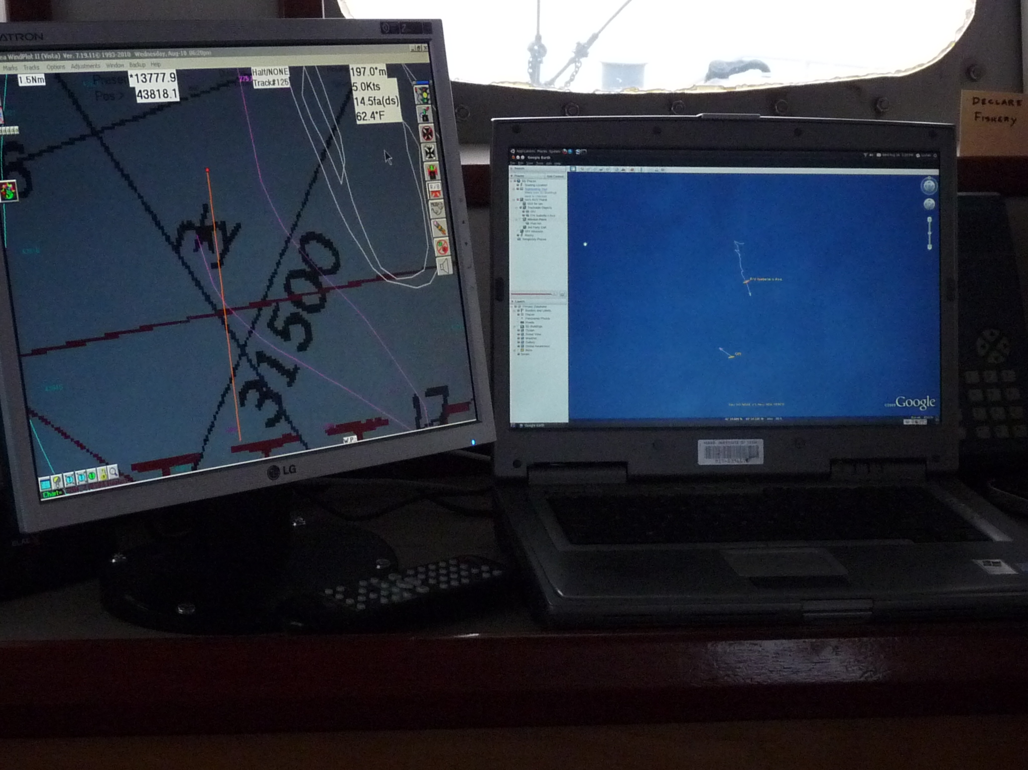
Fits well with navigation systems in wheelhouse

Slide 24
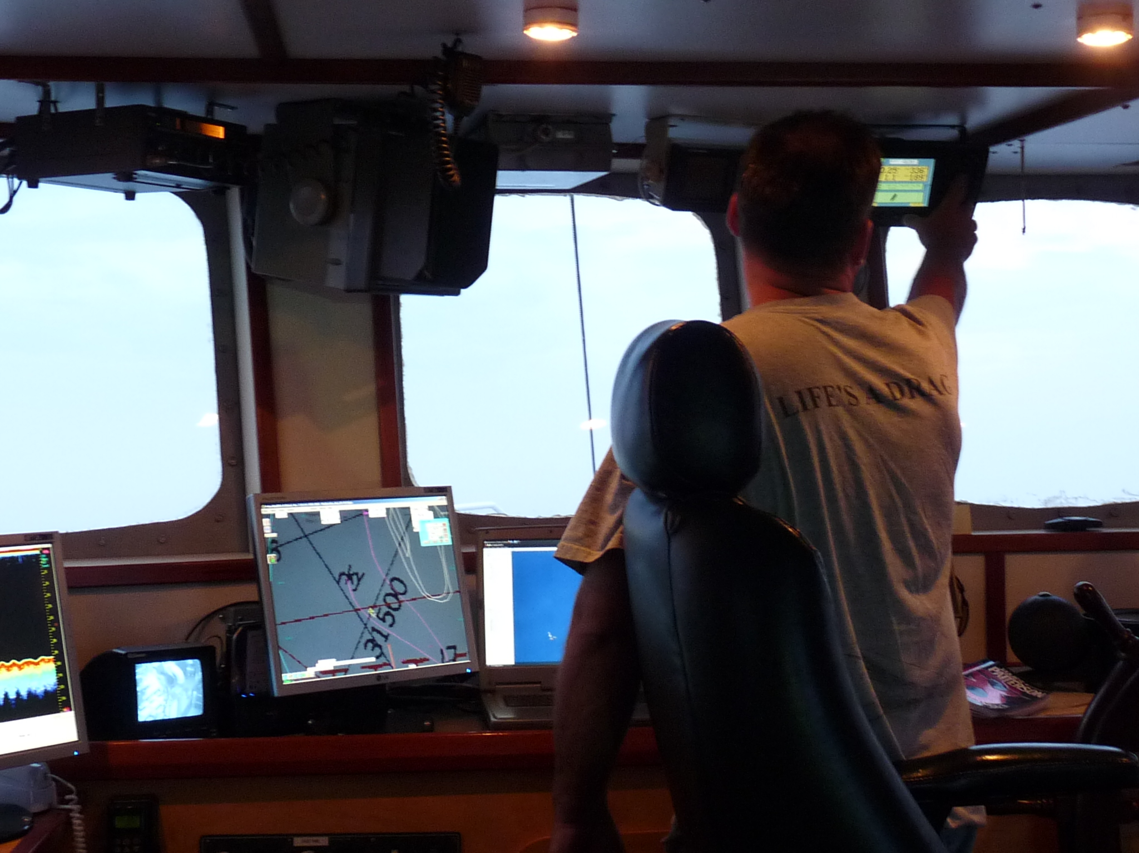
Captains use it effectively
Notes:
They read the coordinates, and punch it into their nav system

Slide 25
Reducing Mission Envelope
In summary:

Slide 26
Recurring tasks must be automated
If you want to save time,
(This is why we invented computers and robots)
Notes:
You don’t have to use my tools, but you should have your own equivalent

Slide 27
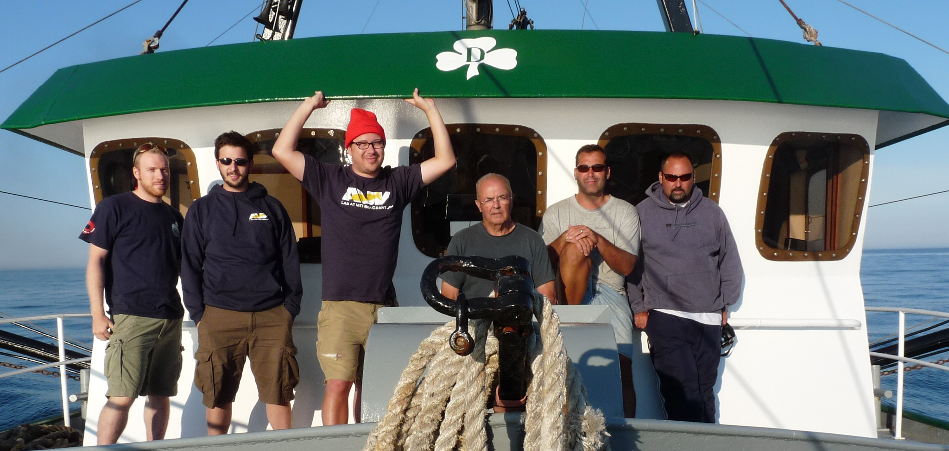
INCLUDE YOUR SHIP’S CREW
Your ops team is bigger than
your development team
Notes:
Make tools that your crew can use. They understand maps, bathymetry, tides, wind, and weather… but you have to deliver it to them.

Slide 28
Part 2
Reducing Intermission

Slide 29
Mission Envelope
Think of a mission
Check your environment
Tides
Depth
Location
Traffic
Configure mission and parameters
Pre-flight checks
Execute mission
Wait for completion
Post-flight checks
Analyze data
Move support vessel if necessary
Repeat
Intermission
Notes:
Refresher: we’re talking what happens between pressing the stop button and knowing what the next mission will cover

Slide 30
Intermission is where decisions are made by the operator
Notes:
In other words, the time when decisions are made

Slide 31
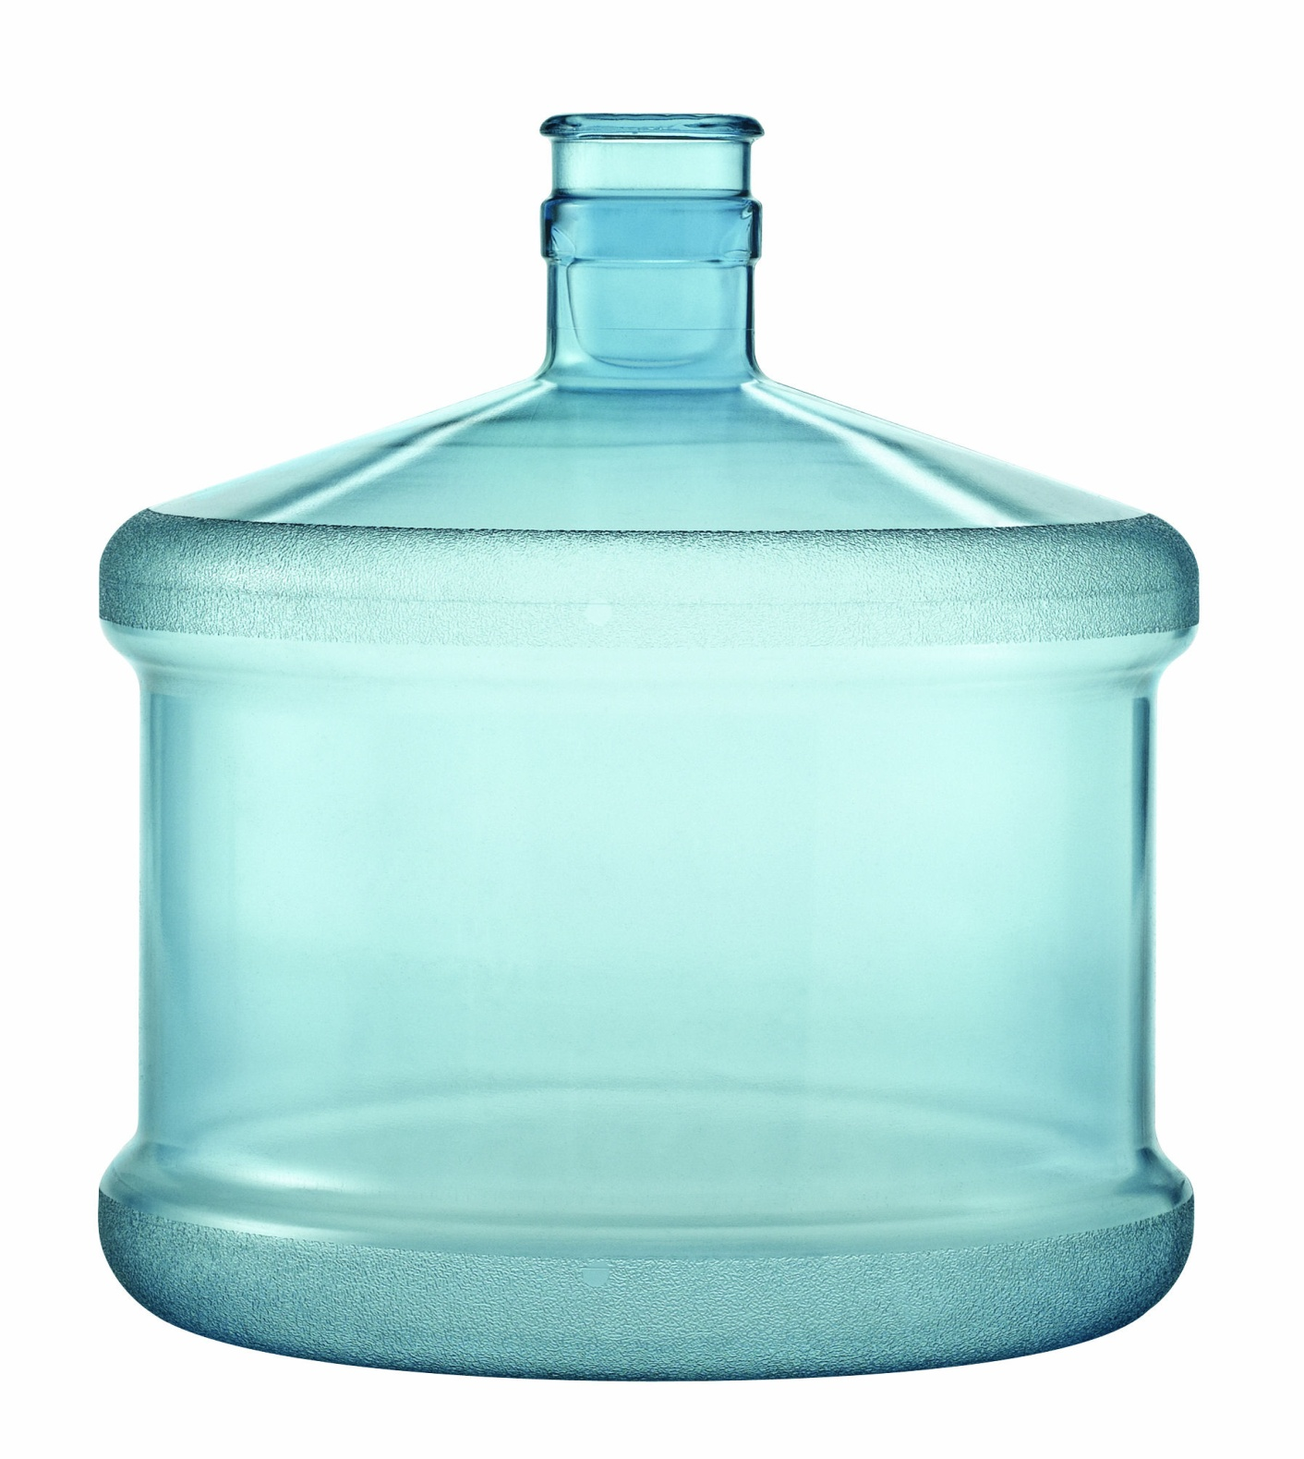
Informed Decisions
25-50 MB of mission data
1-2 GB of bitmap images
108 KB/s max transfer rate
(37 KB/s in practice)
Data: 10-20 minutes
Images: 8-16 hours
Notes:
About $100 of ship time, just for the data … and $10 per image

Slide 32
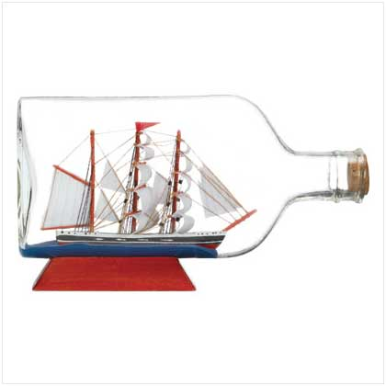
We Can Beat the Bottleneck
Granularity
Compression
Caching

Slide 33
Long Story Short
Use a database for logging,
use a webserver for reporting
Notes:
Database gives you granularity, properly programmed webpages give you the rest. I’m not going to waste time here with a demo, so here are screenshots. See me after if you want to try it for yourself.

Slide 34
Notes:
Say we’ve just finished with mission 575. the vehicle has just surfaced from mission 576.

Slide 36
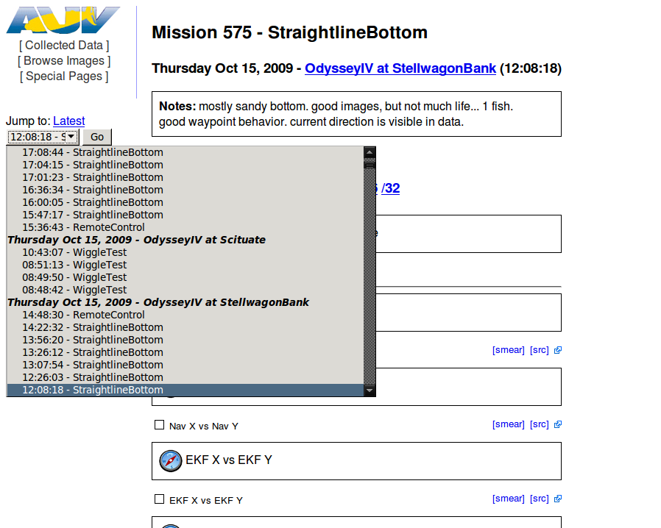

Slide 39
All kinds of clicky

Slide 41
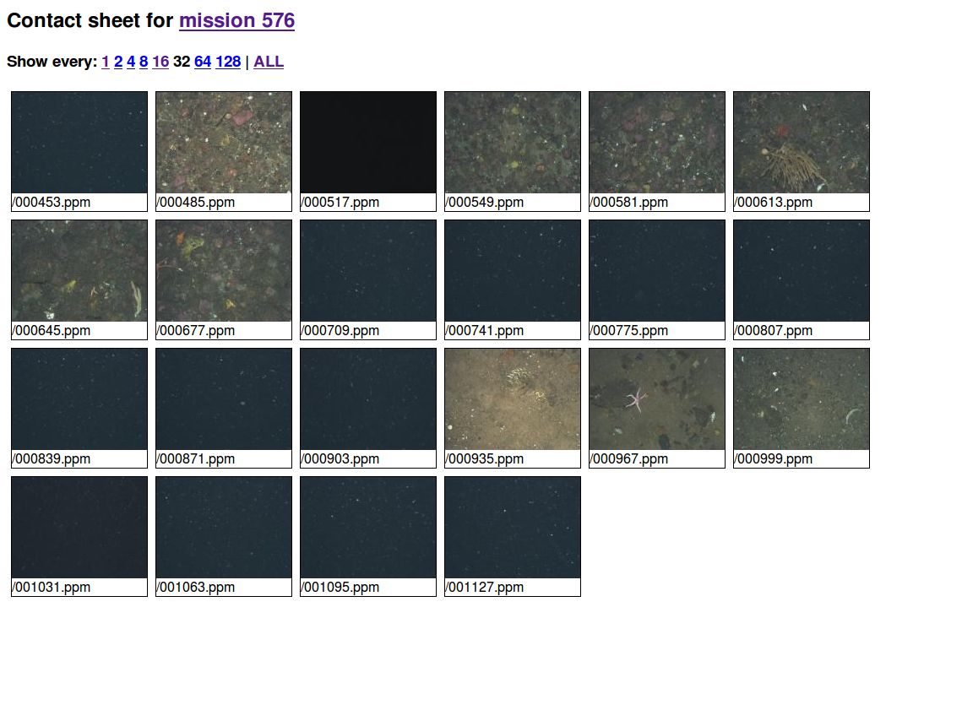
JPEG compression and caching
Notes:
This is where compression and caching come in – we convert to jpg and scale down the images. We also start by viewing every 32nd image.

Slide 42
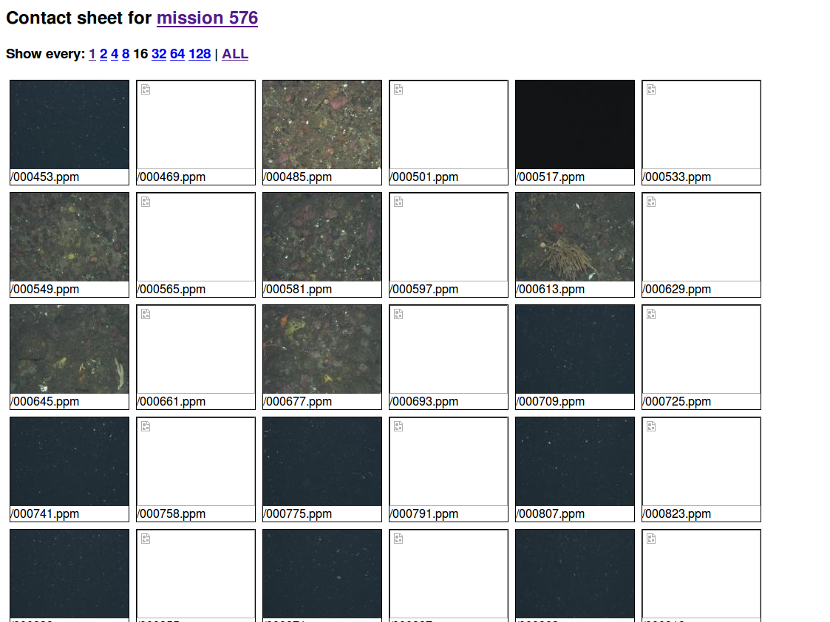
Notes:
We can essentially zoom out if we need more information

Slide 43
Notes:
The rest of the mission summary page is click-to-load flash charts of the most common things that we monitor

Slide 44
All kinds of clicky

Slide 46
All kinds of clicky

Slide 48
All kinds of clicky

Slide 50
All kinds of clicky

Slide 51
Notes:
We also have a link back to the summary page for this date and site

Slide 52
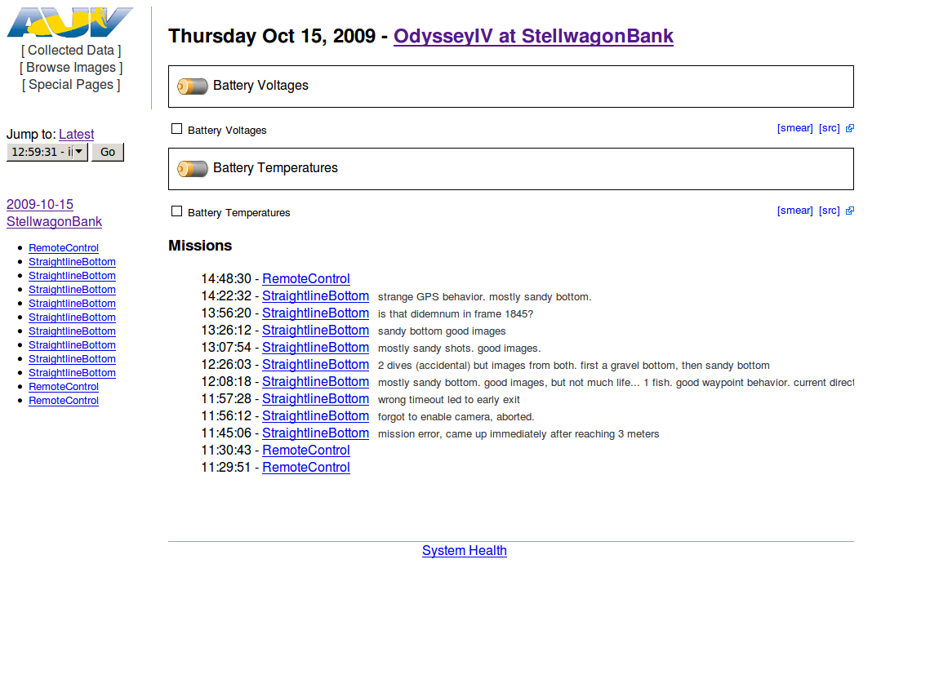
All kinds of clicky

Slide 53
All kinds of clicky

Slide 54
All kinds of clicky

Slide 55
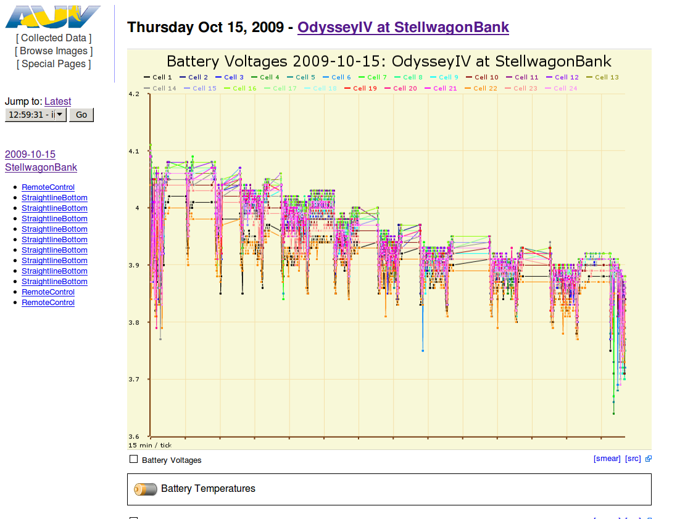
All kinds of clicky

Slide 56
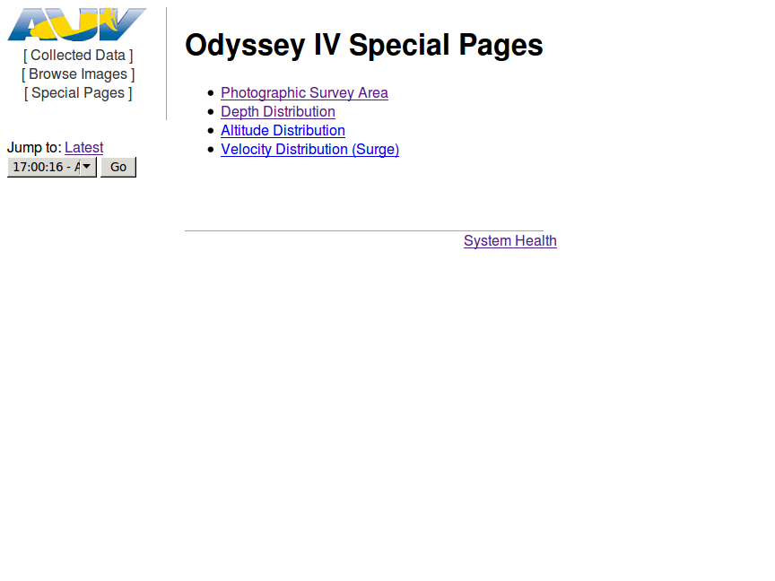

Slide 58
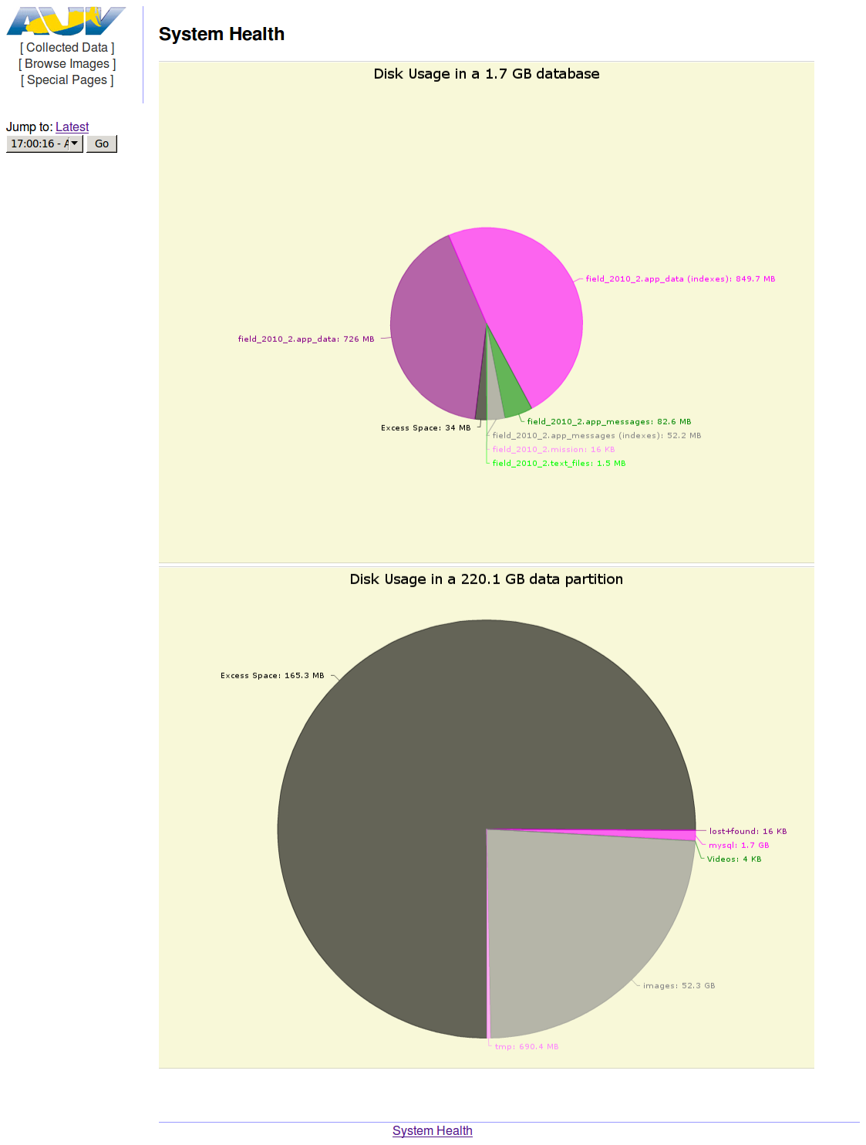

Slide 61
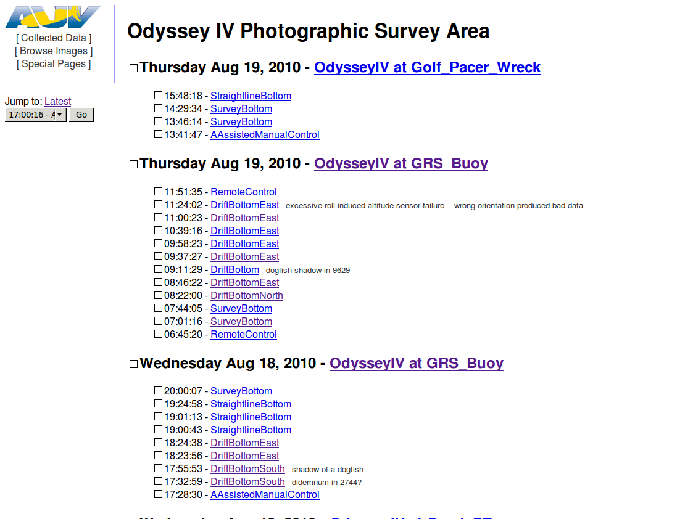

Slide 62
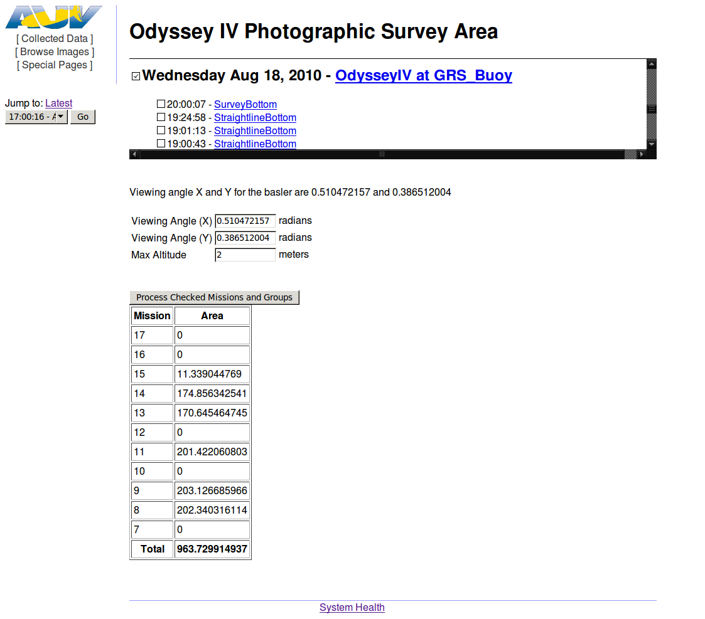

Slide 63
Google Earth Integration
Through KML generation

Slide 64
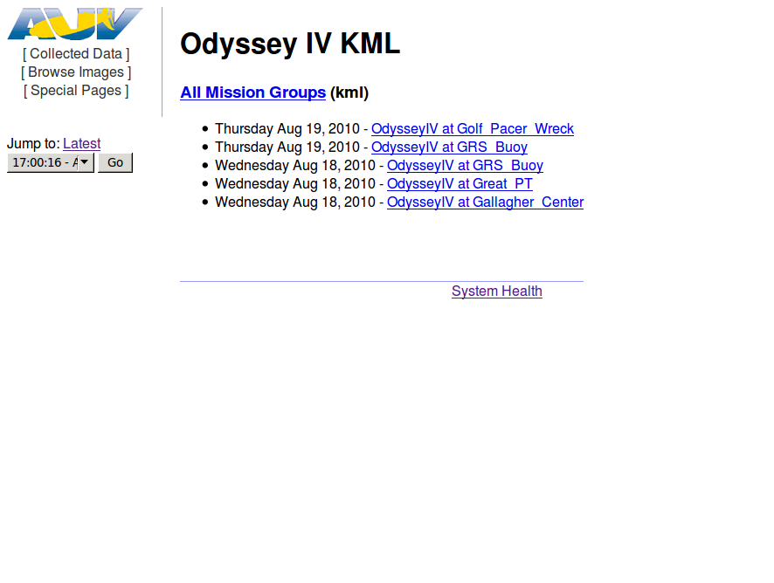

Slide 65
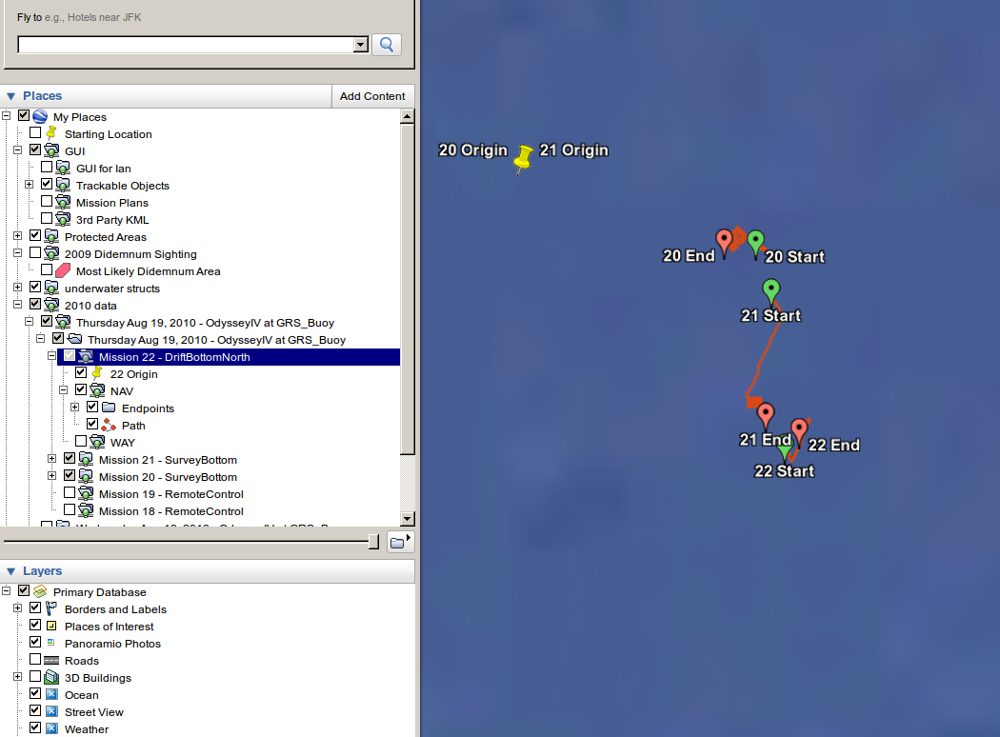
Lazy Evaluation

Slide 66
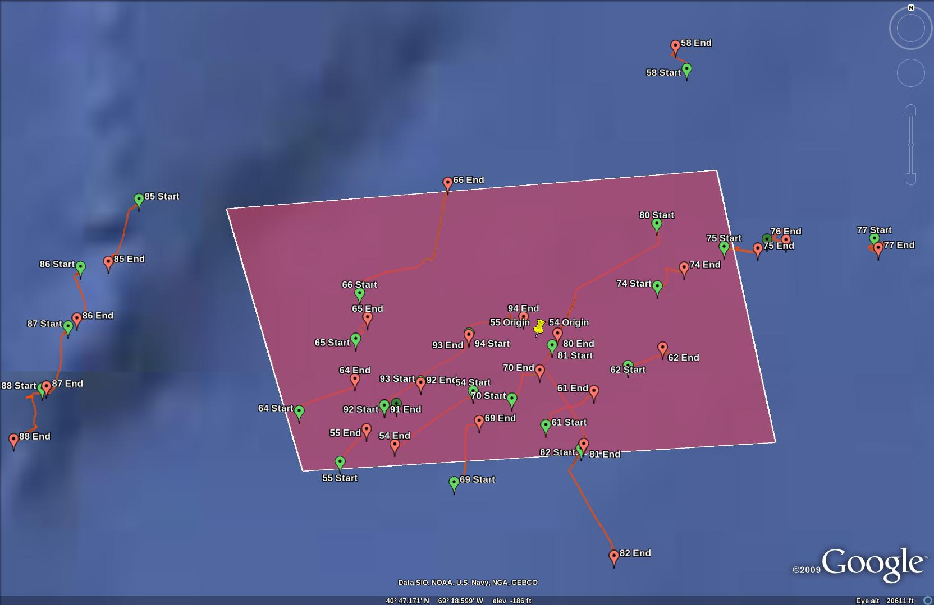
Covering an Area of Interest

Slide 67
Is It Actually Useful?
Does it actually save time?
Notes:
Database gives you granularity, properly programmed webpages give you the rest. I’m not going to waste time here with a demo, so here are screenshots. See me after if you want to try it for yourself.

Slide 68
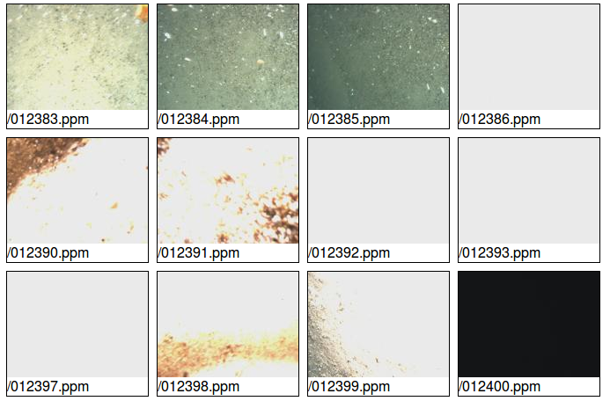
Actual Problem From 2010 Ops

Slide 69
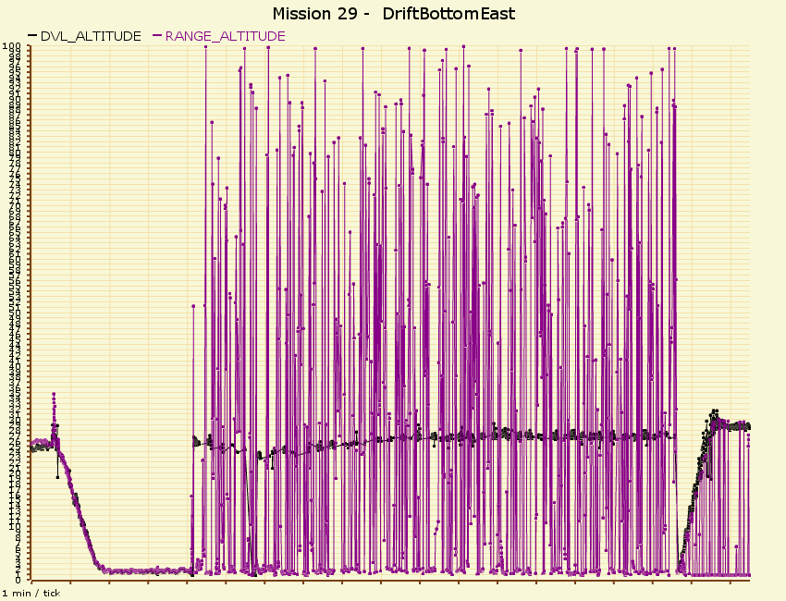
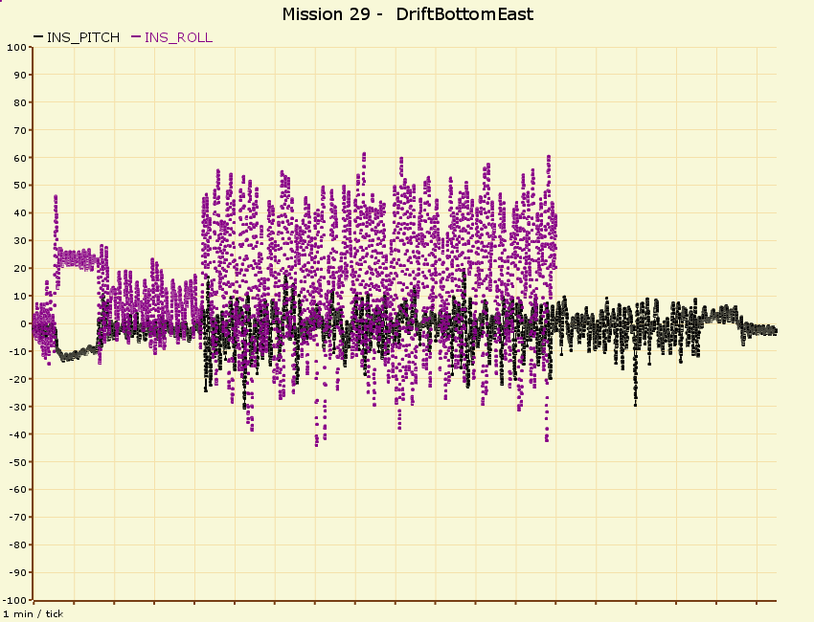
Diagnosed in 3 Clicks

Slide 70
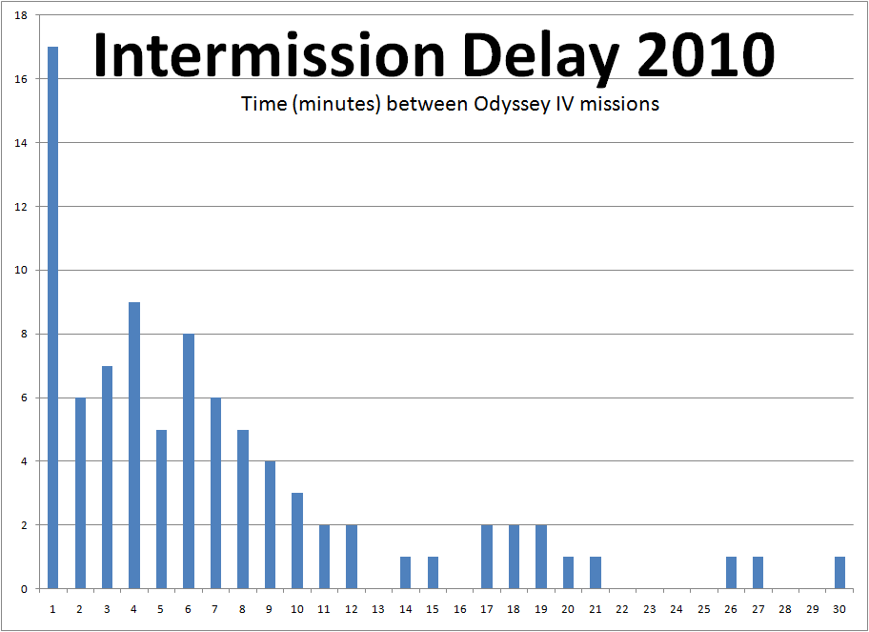
Notes:
How well did we do? This is a histogram of intermission times for our last month of ops.

Slide 71
Reducing Intermission
In summary:

Slide 72
Data is your product
Your algorithm is not your product
Make sure you can assess it easily
Notes:
Not access it, assess it… make sure you’re getting what you need. Collect data as fast as possible and stay on track

Slide 73
Part 3
Reduce Error

Slide 74
Operator errors negate any & all engineering miracles
No matter how much work is done
to optimize the vehicle hardware and software,

Slide 75
Common Errors
Lat,Lon – the reverse of X,Y
Mismatched timeouts in parallel actions
Typo in start/stop flag
1 wrong mission costs you a measurable fraction of your operating day

Slide 76
Failure Cases
Best case: premature radio contact
Acceptable case: late radio contact
Worst case: no radio contact

Slide 77
Use a 3d environment to plan 3d missions
Instead of scripting missions via text files

Slide 78
Mission Planning with Google Earth
(Supposedly Impossible)
Watch on youtube:
“Interactive AUV Planning with Google Earth”
http://www.youtube.com/watch?v=vK0wWH9Ijnk

Slide 79
3 Ways to Make the Most of Ops:
Reduce mission envelope
Reduce intermission
Reduce error
Notes:
This are the 3 things I’m going to talk about today

Slide 80
In Summary:

Slide 81
Have An efficient operations cycle
A faulty algorithm
won’t slow you down – if you
The reverse is not true.
Notes:
Not access it, assess it… make sure you’re getting what you need

Slide 82
Looking Ahead

Slide 83
Protovis Javascript/SVG Library for Graphing

Slide 84
Lua for Configuration and Mission Scripting

Slide 85
Ask Me Anything

